Slide 1
Unit 4

Slide 2
Basic Computer Organization and Design
Instruction and Instruction Code
Computer Instructions
Timing and Control
Instruction Cycle
Memory Reference Instructions
Input/Output and Interrupts
Complete Computer Description
Machine Language
Assembly Language
The Assembler

Slide 3
Program Loops
Programming Arithmetic & Logic
Subroutines
Inputs/Outputs Programming
Microprogrammed Control
Control Memory
Address Sequencing
Microprogram Example
Design Control Unit

Slide 4
SESSION:9
Instruction and Instruction Code
Computer Instructions
Timing and Control
Instruction Cycle
Memory Reference Instructions
Input/Output and Interrupts
Complete Computer Description

Slide 5
Instruction and Instruction Code
The collection of bits that instruct the computer to perform a specific operation is called an instruction code. Operation part is the most basic part of an instruction code. The operation code of an instruction is a group of bits that define such operations as add, subtract, multiply, shift and complement. The total number of operations available in the computer determines the number of bits required for the operation code of an instruction. The operation code must consist of at least n bits for a given 2^{n} (or less) distinct operations. An ‘operation’ is a binary code, that instruct
the computer to perform a specific operation. The control unit gets the instruction from memory and interprets the operation code bits. It then issues a sequence of control signals to initiate micro-operations in internal computer registers. For every operation code, the control issues a sequence of micro-operations required for the hardware implementation of the specified operation.

Slide 6
This operation should be performed on some data stored in processor registers or on the data stored in the memory. Hence an instruction code must specify both the operation and the registers or the memory words where the operands are to be found, as well as the registers or the memory word where the operands be stored. Memory words can be specified in instruction codes by their address. Processor registers can be specified by assigning to the instruction another binary code of K bits that specifies one of 2^{K} registers. There are many variations for arranging the binary code of instructions. Each computer has its own particular instruction code format called its Instruction Set.

Slide 7
Stored Program Organization
Generally a computer has one processor register and an instruction code format with two parts. The first part describes the operation to be performed and the second refers to an address. The memory address describes the control where to find an operand in memory. Instructions and data are stored in two separate sections of memory. For a memory unit with 4096 words we need 12 bits to specify an address since 2¹² = 4096. If each instruction code is stored, in one 16-bit memory word, four bits are available for the operation code (i.e. abbreviated opcode) to specify one out of 16 possible operations and 12 bits to specify the address of an operand. The control reads a 16-bit instruction from the program portion of memory. It then executes the operation specified by the operation code. If an operation in an instruction code does not require an operand from memory, we can use the rest of the bits in the instruction for other purposes. It is easier to use the address bits of an instruction code not as an address but as the actual operand. The instruction is said to have an immediate operand when the second part of an instruction code specifies an operand. When the second part specifies the address of an operand, the instruction is referred to as a ‘direct address’. A third possibility is called indirect address where the bits in the second part of the instruction refers to an address of a memory word in which the address of the operand is found. We use one bit of the instruction code to distinguish between a direct and an indirect address. The memory word that holds the address of the operand in an indirect address instruction is used as a pointer to an array of data. The pointer could be placed in a processor register instead of memory as done in commercial computers.

Slide 8
Computer Registers
Computer instructions are generally stored in consecutive memory locations. These instructions are executed sequentially one at a time. In one operation the control reads an instruction from a specific address in memory and executes it and the process is repeated. This instruction sequencing needs a counter to calculate the address of the next instruction after each execution. It is also necessary to provide a register in the control unit for storing the instruction code after it is read from memory. The computer needs processor register for manipulating data and a register for holding a memory address. These requirements are listed in Table 4.1 with a brief description of their functions and the number of bits that they contain.

Slide 9
List of Registers for the Basic Computer

Slide 10
Register Symbol
Number of bits
Register name
Function
DR
16
Data Register
Holds memory operand
AR
12
Address Register
Holds address for memory
AC
16
Accumulator
Processor register
IR
16
Instruction register
Holds instruction code
PC
12
Program counter
Holds address of instruction
TR
16
Temporary register
Holds temporary data
INPR
8
Input register
Holds input character
OUTR
8
Output register
Holds output character

Slide 11
For input and output two registers are used. The Input register (INPR) receives an 8-bit
character from an input device. The Output register (OUTR) holds an 8-bit character for an output device.

Slide 12
Common Bus System
The basic computer consists of eight registers, a memory unit and a control unit. To transfer information from one register to another and between memory and registers, paths must be provided. The number of wires used become excessive if connections are made between the outputs of each register and the inputs of the other registers. A common bus is an efficient scheme for transferring information in a system with many registers is to use. We have shown in previous chapter how to construct a bus system using MUXs or three state buffer gates.

Slide 13
Computer Instructions
The basic computer uses three instruction code formats as shown in the following figure 4.3. Each format has 16 bits. The operation code (opcode) part has three bits and the meaning of the remaining 13 bits depends on the operation code. A memory reference instruction uses 12 bits to specify an address and one bit to specify the addressing mode I, which is equal to 0 for direct address and 1 for indirect address. The register reference instructions are recognized by the operation code 111 with a 0 in the left most bit (bit15) of the instruction.

Slide 14
A register reference instruction specifies an operation or a test of the AC register.
1514 1211 0
I Opcode Address Memory-reference instrution
15 1211 0
0 1 1 1 (b) Register-reference instruction
15 1211 0
1 1 1 1 (c) Input Output instruction

Slide 15
An operand from memory is not needed, therefore, the other 12 bits are used to specify the operation or test to be executed. Similarly, an input-output instruction does not need a reference to memory and is recognized by the operation code 111 with a 1 in the left most bit of the instruction. The remaining 12 bits are used to specify the type of input-output operation or test performed.

Slide 16
The type of instruction can be found by the computer control from the four bits in positions 12 through 15 of the instruction. If the three opcode bits in positions 12 though 14 are not equal to 111, the instruction is a memory reference type and the bit in position 15 is taken as the addressing mode I. If the 3 bit opcode is 111, then bit position 15 is checked. If this bit is 0, the instruction is a register reference type. If the bit is 1, the instruction is an input-output type. The bit in position 15 of the instruction code is designated by the symbol I, and it is not used when operation code is equal to 111.

Slide 17
Three bits of the instruction are used for the operation code. The computer is restricted to a maximum of eight distinct operations since register reference and I/O instructions use the remaining 12 bits as part of the total number of instruction chosen for the basic computer is equal to 25.

Slide 18
The instructions for the computer are listed in Table 4.2. The symbol reference is a three-letter word and represents an abbreviation intended for programmers and users.

Slide 19
Hexadecimal code
Symbol
I = 0
I = 1
Description
AND
0xxx
8xxx
AND memory word to AC
ADD
1xxx
9xxx
Add memory word to AC
LDA
2xxx
Axxx
Load memory word to AC
STA
3xxx
Bxxx
Store content of AC in memory
BUN
4xxx
Cxxx
Branch unconditionally
BSA
5xxx
Dxxx
Branch and save return address
ISZ
6xxx
Exxx
Increment and skip if zero
CLA
7800
Clear AC

Slide 20
CLE
7400
Clear E
CMA
7200
Complement AC
CME
7100
Complement E
CIR
7080
Circulate right AC and E
CIL
7040
Circulate left AC and E
INC
7020
Increment AC
SPA
7010
Skip next instruction if AC positive
SNA
7008
Skip next instruction if AC negative
SZA
7004
Skip next instruction if AC zero
SZE
7002
Skip next instruction if E is 0
HLT
7001
Halt computer

Slide 21
INP
F800
Input character to AC
OUT
F400
Output character from AC
SKI
F200
Skip in input flag
SKO
F100
Skip on output flag
ION
F080
Interrupt on
IOF
F040
Interrupt off

Slide 22
Student Activity
What is the significance of instruction?
Describe basic computer registers.
How computer instructions are identified?

Slide 23
Timing and Control
A master clock generator controls the timing for all registers in the basic computer. The clock pulses are applied to all flip-flops and registers in the system and in the control unit. The clock transition does not change the state of a register unless the register is enabled by a control signal. The control unit generates the control signals and provide control inputs for the multiplexers in the common bus, control inputs in processor registers and micro-operations for the accumulator. Control organizations are classified as Hardwired control and microprogrammed control.

Slide 24
Hardwired organization, uses gates, flip flops etc to implement the control logic. It is advantageous in that it can be optimized to produce a fast mode of operation. The control information is shared in a control memory, in a micro programmed organization. The control memory is programmed to begin the desired sequence of micro-operation. A hardwired control, requires changes in the wiring among the various components if the design has to be changed.

Slide 25
The rising edge of a timing signal initiates a memory read or write cycle. We assume that a memory cycle time is less than the clock cycle time. By this assumption a memory read or write cycle initiated by a timing signal will be completed by the time the next clock goes through its positive transition.

Slide 26
Instruction Cycle
A program stays in the memory unit of the computer and has a sequence of instructions. The program is executed by going through a cycle for each instruction. Each instruction cycle is now subdivided into a sequence of sub cycles or phases. In the basic computer each instruction cycle has the following parts:

Slide 27
Fetch an instruction from memory.
Decode the instruction.
Read the effective address from memory if the instruction has an indirect address.
Execute the instruction.
After the completion of step 4, the control goes back to step 1 to fetch, decode and execute the next instruction. This process continues indefinitely unless a HALT instruction is encountered.

Slide 28
Fetch & Decode
The program counter PC is loaded first with the address of the starting instruction in the program. The sequence counter SC is set to zero to provide a decoded timing signal T₀. T_{t} is required to transfer the address from PC to AR during the clock transition associated with timing signal, because only AR is connected to the address inputs of memory. The instruction read from memory is then placed in the instruction register IR with the clock transition associated with timing signal T₁.

Slide 29
At the same moment PC is incremented by one to prepare it for the address of the next instruction in the program. At time T₂, the operation code in IR is decoded, the indirect bit is transferred to flip-flop I and the address part of the instruction is transferred to AR. SC is incremented after each clock pulse to produce the sequence T₀, T₁ and T₂. During time T₃, the control unit determines the type of instruction that was just read from memory.

Slide 30
Memory Reference Instructions
The seven memory-reference instructions The decoded output is from the decoder and it is designated by D_{i} where i is from 0 to 6. The address register AR gives the effective address (EA) of the instruction. The EA is taken and it is placed there during timing signal T₂ (I = 0), or during timing signal T₃ when I = 1. The execution of the memory-reference instructions begins with timing signal T₄. We use register transfer notation to give the symbolic description of each instruction as it is clear from the table.

Slide 31
In a bus system the actual execution of the instruction requires a sequence of micro operations. This is because data stored in memory cannot be processed directly. We have to read data from memory and transfer it to a register where they can be operated on with logic circuits. Now we can describe the operation of each instruction. We also give the control functions and micro operations required for their execution.

Slide 32
Symbol
Operation decoder
Symbolic description
AND
D₀
AC← AC M[AR]
ADD
D₁
AC← AC + M[AR], E← C_{out}
LDA
D₂
AC← M[AR]
STA
D₃
M[AR], ←AC
BUN
D₄
PC← AR
BSA
D₅
M[AR] ← PC, PC← AR+1
ISZ
D₆
M[AR] ← M[AR]+1
IF M[AR] +1 = 0 then PC← PC+1

Slide 33
AND to AC
This instruction performs the AND logic operation on pairs of bits in AC and the memory word specified by the effective address. The result of the operation is transferred to Accumulator. The micro operations that execute this instruction are:

Slide 34
D₀T₄: DR←M[AR]
D₀T₅: AC←AC ∧ DR, SC←0.

Slide 35
ADD to AC
The content of the memory word specified by the effective address is added to the value of AC with the help of this instruction. The sum is transferred into accumulator and the output carry C_{out} is transferred to the E (extended accumlator) flip-flop. The microoperations needs to execute this instruction are:

Slide 36
D₁T₄: DR←M[AR]
D₁T₅: AC←AC + DR, E ← C _{out}, SC←0

Slide 37
LDA: Load to AC
This instruction is used to transfers the memory word specified by the effective address to accumulator. Following micro operations are needed to execute this instruction:
D₂T₄: DR←M[AR]
D₂T₅: AC←DR, SC←0

Slide 38
STA: Store AC
This Instruction is used to store the content of accumulator into the memory word specified by the effective address. Since the output of AC is applied to the bus and the data input of memory is connected to the bus, we can execute this instruction with one micro operation:
D₃T₄: M[AR] ←AC, SC ← 0

Slide 39
BUN: Branch Unconditionally
This instruction is used to transfer the program to the instruction located at the effective address. We already know that program counter holds the address of that instruction which is to be read from memory in the next instruction cycle. Program Counter is incremented at time T₁ to make ready it for the address of the next instruction in the program sequence. This instruction allows the programmer to specify an instruction out of sequence i.e. the program branches (or jumps) unconditionally. The instruction requires only one microoperation:
D₄T₄: PC ←AC, SC ← 0

Slide 40
With the help of common bus, the effective address from AR reaches to PC. The control transfers to T₀ by resetting SC to 0. Now the next instruction is fetched. This is then executed from the memory address given by the new value in PC.

Slide 41
BSA: Branch and Save Return Address
This is a useful instruction for branching to a portion of the program called a subroutine. When BSA instruction is executed, it stores the address of the next instruction in sequence (which is available in PC) into memory location specified by the effective address. To serve as the address of the first instruction, the effective address plus one is transferred to PC in the subroutine. This operation was specified in with the following register transfer:
M[AR] ← PC, PC ← AR + 1

Slide 42
To demonstrate this, a numerical example shows how this instruction is used with a subroutine (Figure 4.4). Assuming that the BSA instruction is in memory at address 20. The I bit is 0 and the address part of the instruction has 135 in binary. PC will contain 21, after the fetch and decode phases. This is the address of the next instruction in the program (referred to as the return address). Address register contains the effective address 135. This is shown in part (a) of the figure. The BSA instruction performs the following numerical operation:
M[135] ← 21, PC ← 135 + 1 = 136

Slide 43
The BSA instruction can be understood as a subroutine call. The indirect BUN instruction at the end of the subroutine performs the function referred to as a subroutine return. In most commercial computers, the return address associated with a subroutine is stored in either a processor register or in a portion of memory (i.e. a stack).

Slide 44
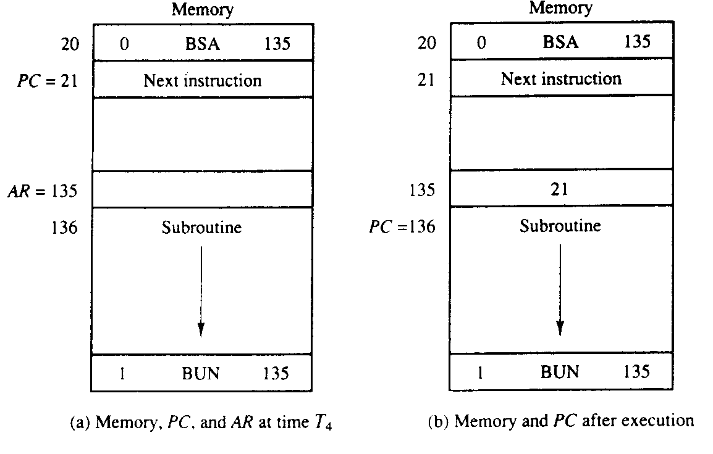

Slide 45
ISZ: Increment and Skip if Zero
ISZ instruction increments the word referred by the effective address, and if the incremented value of the word is equal to 0, PC is incremented by 1. A negative number in 2's complement form is generally stored in the memory word. Since this negative number is continually incremented by one, at last it becomes zero. At that time to skip the next instruction PC is incremented by one in order.

Slide 46
Now we have to read the word into DR, increment DR, and store the word back into memory, because it is not possible to increment a word inside the memory,. This can be done with the following sequence of micro operations:
D₆T₄: DR ←MR[AR]
D₆T₅: DR ← DR + 1
D₆T₆: M[AR] ←DR, if (DR = 0) then (PC ← PC +1), SC ← 0

Slide 47
Control Flowchart
It should be noted that we need only seven timing signals to execute the longest instruction (ISZ). The computer can be designed with a 3-bit sequence counter. The reason for using a 4-bit counter for SC is to provide additional timing signals for other instructions that are presented in the problems section.

Slide 48
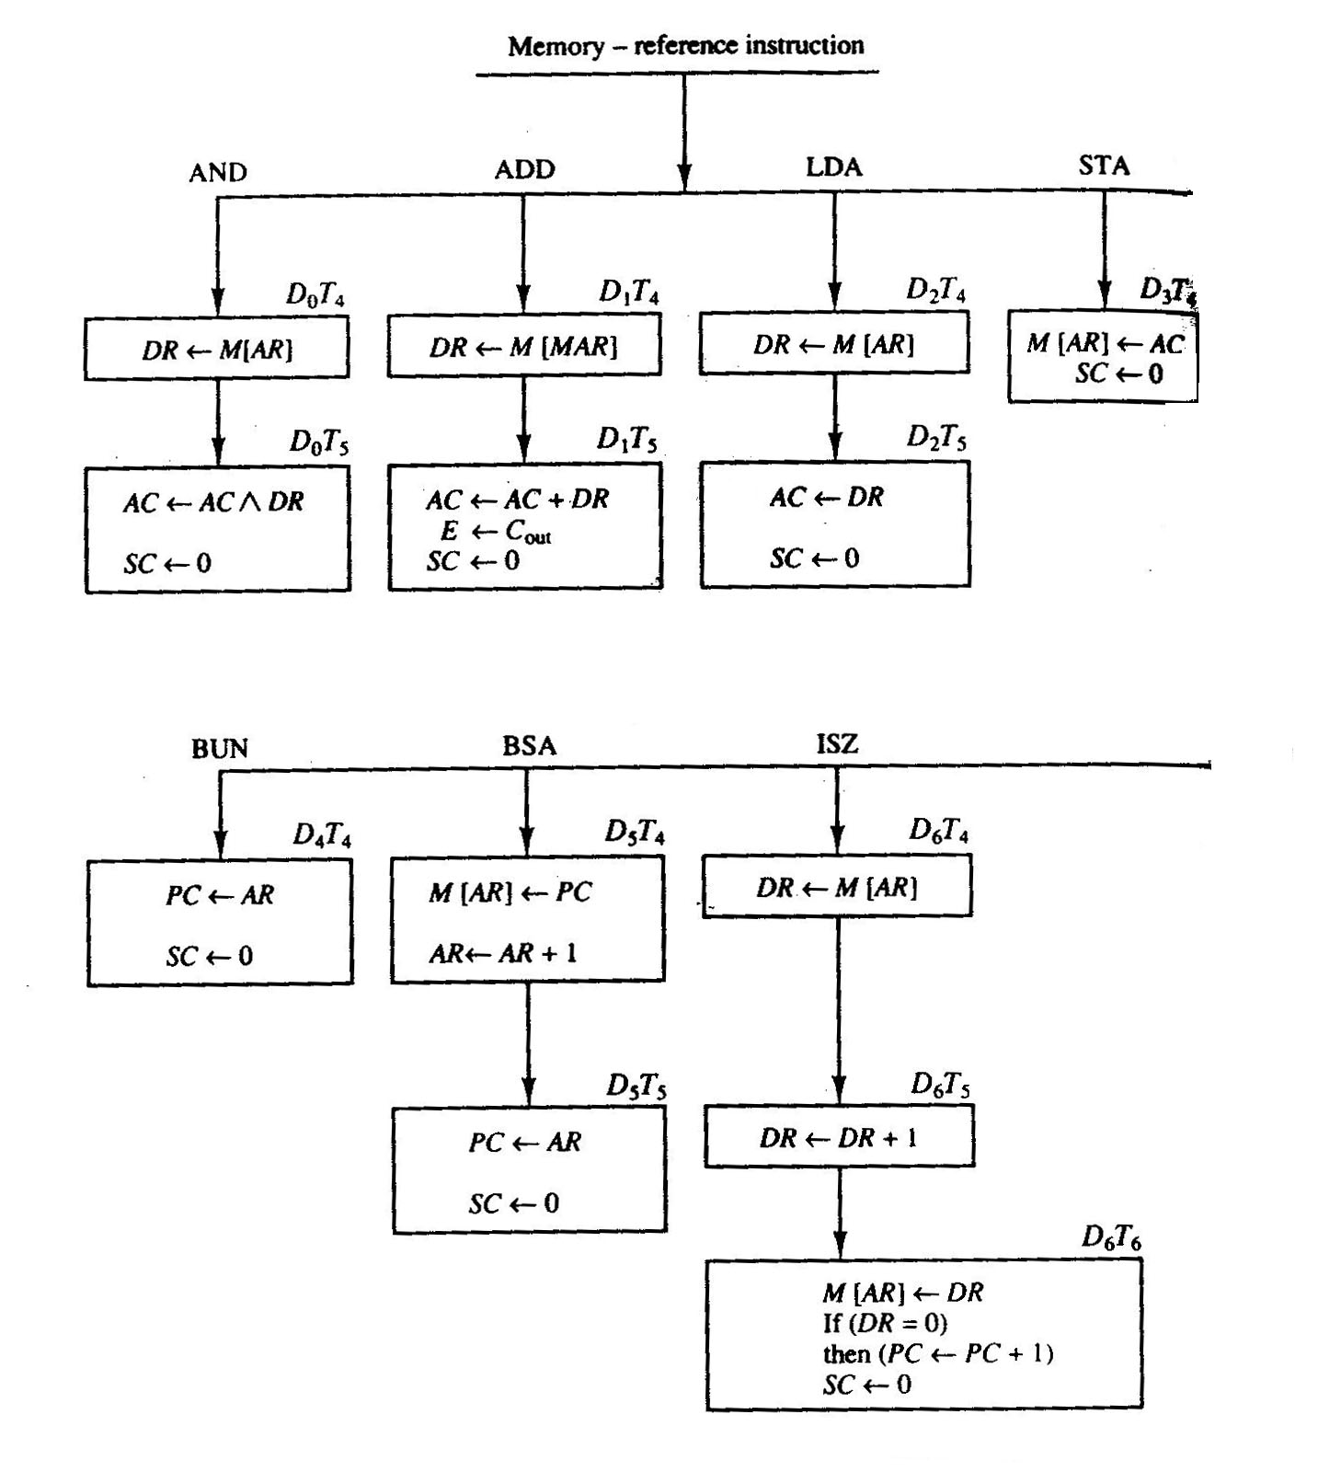

Slide 49
Student Activity
1. Give different phases of instruction cycle.
2. Distinguish between Hardwired control and micro programmed control.

Slide 50
Input, Output and Interrupt
An alphanumeric code of eight bits is required for each quantity of information. The serial information from the keyboard is shifted into the input register INPR. The output register OUTR stores the serial information for the printer. These two registers communicate with a communication interface serially and with the accumulator in parallel. The I/O configuration is shown in following figure.

Slide 51
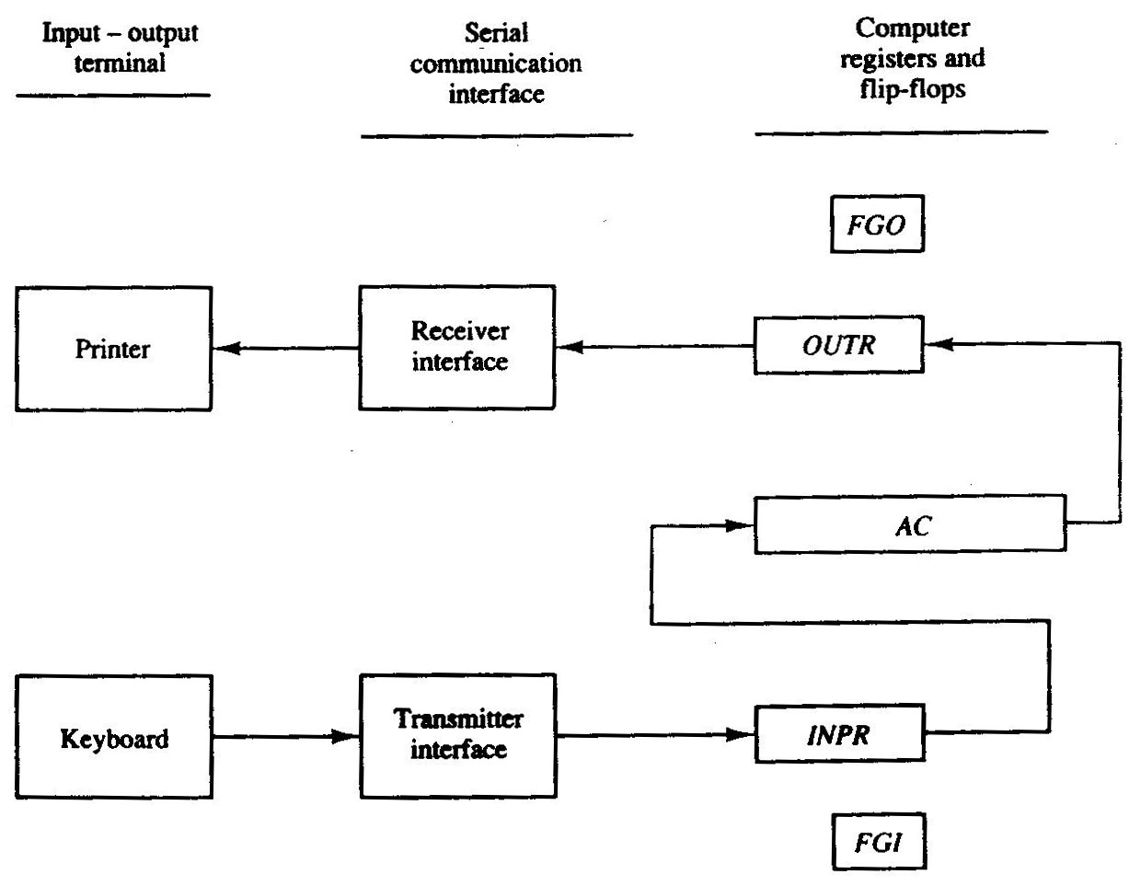

Slide 52
Program Interrupt
The interrupt enables flip-flop IEN can be set (to 1) and cleared (to 0) with two instructions. When IEN is cleared the flags cannot interrupt the computer. When IEN is set, it means that the computer can be interrupted. With the help of these two instructions a programmer can now decide whether or not to use the interrupt facility. An interrupt flip-flop R is included in the computer. When R = 0, the computer goes through an instruction cycle. While the execution phase of the instruction cycle IEN is checked by the control. If it is 0, it means we do not want to use the interrupt, therefore control continues with the next instruction cycle. If IEN is 1, control checks the flag bits. If both flags are 0, then it shows that neither the input nor the output registers are ready for information transfer. In this case, control continues with the next instruction cycle. If either flag is set to 1 while IEN = 1, flip-flop R is set to 1.

Slide 54
Complete Computer Description
Complete Computer Description is given in the flowchart. It consists of instruction cycle, including the interrupt cycle for the basic computer as shown in Figure 4.7. The interrupt flip-flop R may be set at any time during the execution phase. Control returns to timing signal T₀ after SC is cleared to 0. If R = 1, the computer goes through an interrupt cycle. If R = 0, the computer goes through an instruction cycle. If the instruction is one of the memory-reference instructions, the computer first checks if there is an indirect address and then continues to execute the decoded instruction according to the flowchart

Slide 55
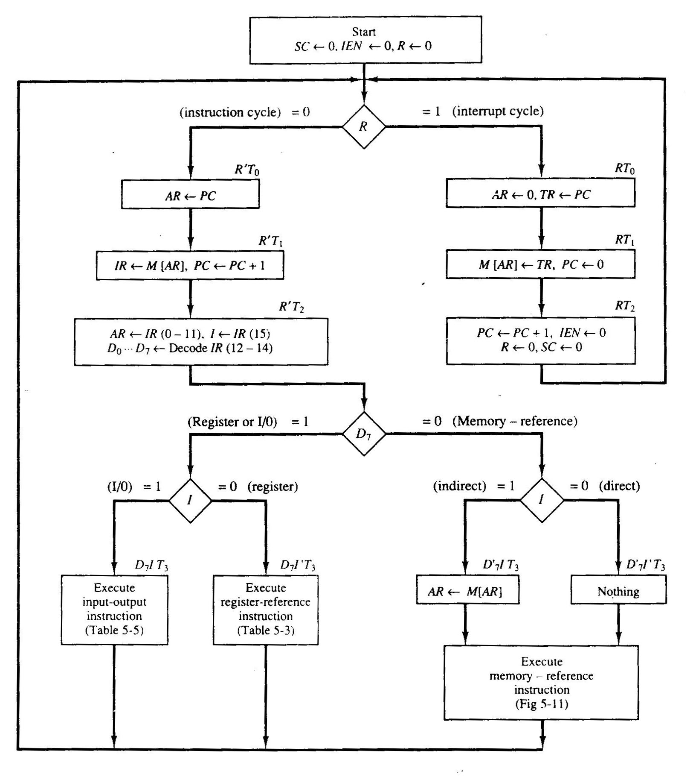

Slide 56
The control functions and micro operations for the whole computer are given in Table 4.4. The register transfer statements in this table shows in a concise form the internal organization of the basic computer. Register transfer statements also provide the information required for the design of the logic circuits of the computer. Boolean functions for the gates is determined by the control functions and conditional control statements listed in the table. The micro operations given in the table give the type of control inputs required for the registers and memory. A register transfer language is useful for specifying the logic circuits needed for its design. It is useful for describing the internal organization of a digital system.

Slide 57
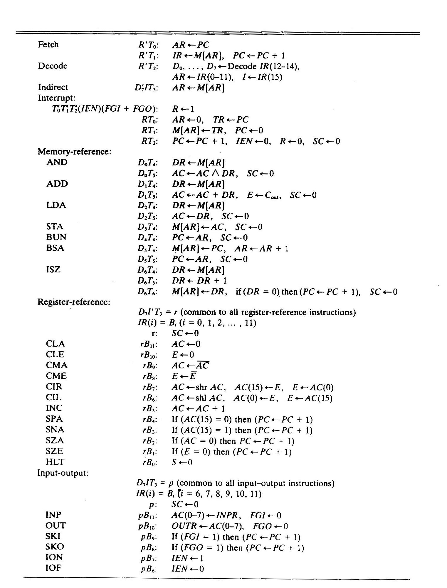

Slide 58
SESSION:10
Machine Language
Assembly Language
The Assembler
Program Loops
Programming Arithmetic & Logic

Slide 59
Machine Language
To write a program for a computer we need to specify, directly or indirectly, a sequence of machine instructions. Machine instructions inside the computer form a binary pattern, which is difficult to understand and manipulate. The instruction set of the basic computer, whose hardware organization was explored earlier used to program a computer. The 25 instructions of the basic computer are in Table 4.5 to provide an easy reference for the programming examples that follow.

Slide 60
Symbol
Hexadecimal code
Description
AND
0 or 8
AND M to AC
ADD
1 or 9
Add M to AC, carry to E
LDA
2 or A
Load AC from M
STA
3 or B
Store AC in M
BUN
4 or C
Branch unconditionally to m
BSA
5 or D
Save return address in m and branch to m+1
ISZ
6 or E
Increment M and skip if zero
CLA
7800
Clear AC
CLE
7400
Clear E

Slide 61
CMA
7200
Complement AC
CME
7100
Complement E
CIR
7080
Circulate right E and AC
CIL
7040
Circulate left E and AC
INC
7020
Increment AC
SPA
7010
Skip if AC is positive
SNA
7008
Skip if AC is negative
SZA
7004
Skip if AC is zero
SZE
7002
Skip if E is zero
HLT
7001
Halt computer

Slide 62
INP
F800
Input information and clear flag
OUT
F400
Output information and clear flag
SKI
F200
Skip if input flag is on
SKO
F100
Skip if output flag is on
ION
F080
Turn interrupt on
IOF
F040
Turn interrupt off

Slide 63
A program is a list of instructions to tell the computer to do needed processing on the data. We can write a program for a computer in various types of programming languages, but this program can be executed by the computer only when it is in binary form. If it is written in some other language it has to be translated to the binary form so that it can be executed by the computer.

Slide 64
Location
Instruction Code
0
0010
0000
0000
0100
1
0001
0000
0000
0101
10
0011
0000
0000
0110
11
0111
0000
0000
0001
100
0000
0000
0101
0011
101
1111
1111
1110
1001
110
0000
0000
0000
0000

Slide 65
Assembly Language
As we know that a programming language is defined by a set of rules. If users want their programs to be translated correctly they must conform to all formats and rules of the language. Every digital computer has its own separate assembly language. The rules for writing assembly language programs are available from the computer manufacturer in the form of documents and manuals.

Slide 66
A line of code is the fundamental unit of an assembly language program. The specific language is defined by a group of rules. This group describes the symbols that can be used. It also tells how a line of code can be made from them. We will now give the rules to write assembly language programs for the basic computer.

Slide 67
Rules for the Assembly Language
A line of code of an assembly language program is divided in three columns called fields. The fields describe the following information.
1.The label: may be empty or it may specify a symbolic address.
2.The instruction: specifies a machine instruction or a pseudo-instruction.
3.The comment: may be empty or it may include a comment.

Slide 68
A symbolic address has one, two, or three alphanumeric characters. But it cannot have more than three alphanumeric characters. The first character is an alphabet; the next two may be alphabets or numeric digits. We can choose the symbols arbitrarily. A symbolic address in the label field is terminated by a comma to make it a label. The instruction field specifies one of the following items:

Slide 69
1.A memory-reference instruction (MRI)
2.A register-reference (i.e. input-output instruction) (non-MRI)
3.A pseudo-instruction with or without an operand

Slide 70
Symbol Information for the Assembler
ORG N
    Hexadecimal number N is the memory location for the instruction or operand listed in the following line
END
    Denotes the end of symbolic program
DEC N
    Signed decimal number N to be converted to binary
HEX N
    Hexadecimal number N to be converted to binary

Slide 71
Student Activity
1.Discuss the advantages and disadvantages of machine language and assembly language.
2.Write an assembly language program to subtract two numbers.
3.Draw flow chart of computer description.

Slide 72
The Assembler
An assembler is a program that takes as input a symbolic language program and produces as output its binary machine language equivalent. The input is called the source program and the resulting binary program is called the object program. The assembler is a program that operates on character strings and produces an equivalent binary interpretation.

Slide 73
Memory Representation of Symbolic Program
The symbolic program must be stored in memory, before starting the assembly process. The user writes the symbolic program on a computer. This symbolic program is taken into memory with the help of a loader program. Since the program consists of symbols, its representation in memory must use an alphanumeric character code. Usually each character is represented by an 8-bit code, in the basic computer. The high-order bit is always 0 and the other seven bits are as described by ASCII code.

Slide 74
Hexadecimal Character Code

Slide 75
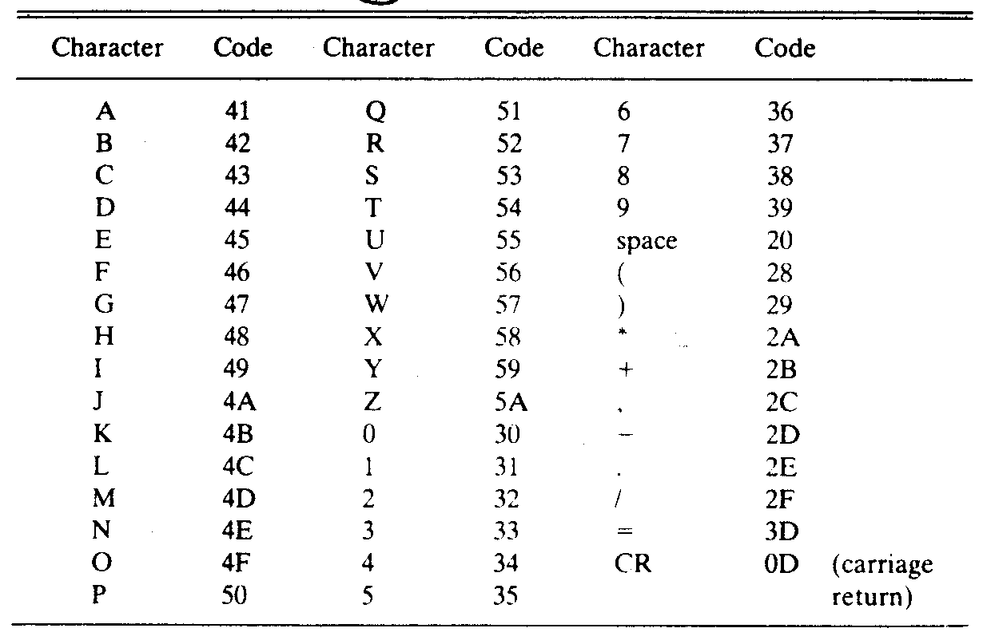

Slide 76
First Pass
Entire symbolic program is scanned by a two-pass assembler twice. After the first pass, it generates a table that correlates all user-defined symbols with their equivalent value in binary. The binary translation is done during the second pass. To keep track of the location of instructions, the assembler uses a memory word called a location counter (abbreviated LC). The content of LC stores the value of the memory location assigned to the instruction or operand presently being processed.

Slide 77
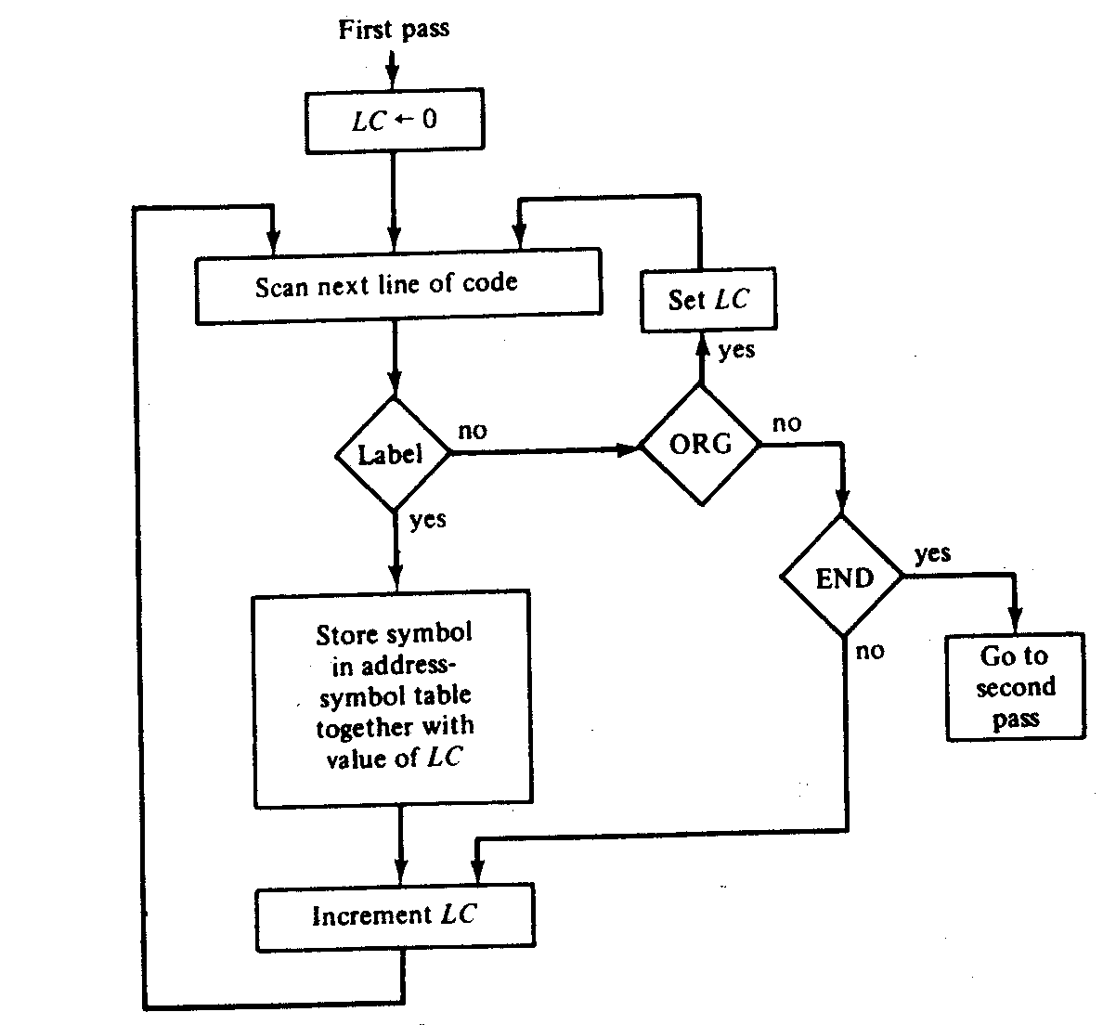

Slide 78
Second Pass
With the help of table-lookup procedures, machine instructions are translated during the second pass. A take-lookup procedure is a search of table entries to find whether a specific item matches one of the items stored in the table. The assembler uses four tables. Any symbol that is encountered in the program must be available as an entry in one of these tables; otherwise, the symbol cannot be interpreted. We assign the following names to the four tables:
1. Pseudo-instruction table.
2. MRI table.
3. Non-MRI table.
4. Address symbol table.

Slide 79
Student Activity
Why assembler is a two-pass software?
Describe first pass of an assembler by flow-chart.

Slide 80
Program Loop
A sequence of instructions that are executed many times, each time with a different set of data is called a program loop. In Fortran, program loops are designated by a DO statement. For example, the following Fortran program forms the sum of 100 integer numbers.

Slide 81
A compiler is a system program that translates a program written in a high-level programming language such as the above to a machine language program. A compiler is more complicated than an assembler because it requires knowledge of systems programming to fully understand its operation. Nevertheless, we can demonstrate the basic functions of a compiler by going through the process of translating the program above to an assembly language program. A compiler may use an assembly language as an intermediate step in the translation or may translate the program directly to binary.

Slide 82
Programming Arithmetic and Logic Operations
In a large system the number of instructions available in a computer may be a few hundred or a few dozen in a small one. Some computers execute a given operation with one machine instruction; some may require many machine instructions to perform the same operation. For example, consider the four basic arithmetic operations. Some computers have machine instructions to add, subtract, multiply, and divide. Others, such as the basic computer, have only one arithmetic instruction, such as ADD. Operations not included in the set of machine instructions must be implemented by a program.

Slide 83
Multiplication Program
The multiplication process consists of checking the bits of the multiplier Y and adding the multiplicand X as many times as there are 1's in Y, provided that the value of X is shifted left from one line to the next. Since the computer can add only two numbers at a time, we reserve a memory location, denoted by P, to store intermediate sums. The intermediate sums are called partial products since they hold a partial product until all numbers are added. As shown in the numerical example under P, the partial product starts with zero. The multiplicand X is added to the content of P for each bit of the multiplier Y that is 1. The value of X is shifted left after checking each bit of the multiplier. The final value in P forms the product. The example has numbers with four significant bits. When multiplied, the product contains eight significant bits. The computer can use numbers with eight significant bits to produce a product of up to 16 bits.

Slide 84
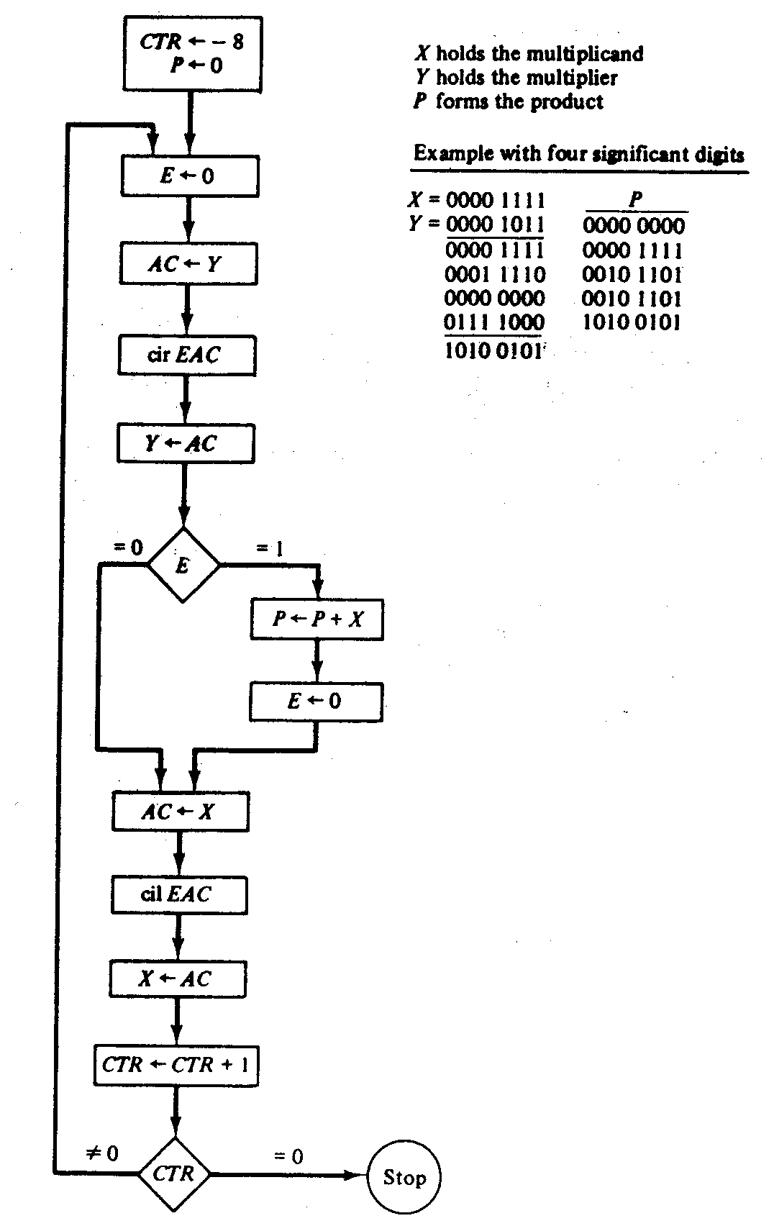

Slide 85
Double-Precision Addition
When we multiply two 16-bit unsigned numbers, the result is a 32-bit product and it must be stored in two memory words. A number is said to have double precision if it is stored in two memory words. When a partial product is computed, it is necessary that a double-precision number be added to the shifted multiplicand, which is also a double-precision number. For greater accuracy, the programmer may wish to employ double-precision numbers and perform arithmetic with operands that occupy two memory words. We now develop a program that adds two double-precision numbers.

Slide 86
Program to Add Two Double-Precision Numbers

Slide 87
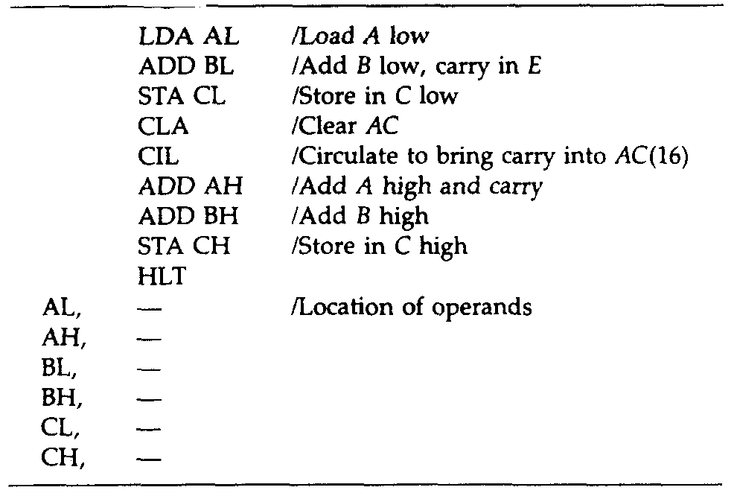

Slide 88
Logic Operations
To perform logic operations: AND, CMA, and CLA, a basic computer has three machine instructions. The LDA instruction is considered as a logic operation that transfers a logic operand into the AC. We listed 16 different logic operations earlier, similarly all 16 logic operations can be implemented by software means because any logic function can be implemented using the AND and complement operations. For example, the OR operation is not available as a machine instruction in the basic computer. From DeMorgan's theorem we recognize the relation x + y = (x'y')'. The second expression contains only AND and complement operations. A program that forms the OR operation of two logic operands A and B is as follows:

Slide 89
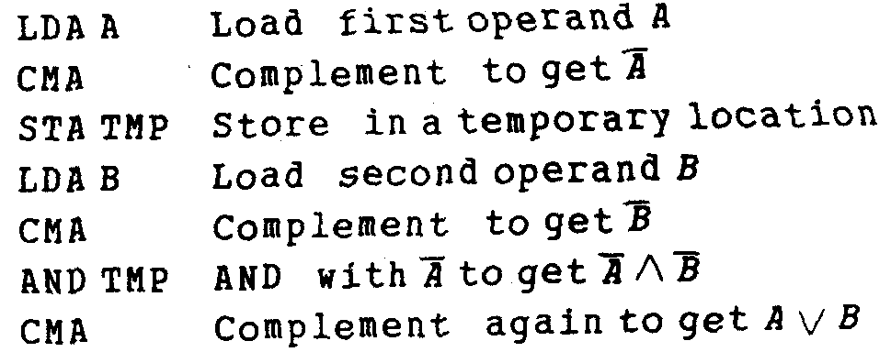

Slide 90
Shift Operations
In a basic computer, the circular-shift operations are machine instructions. The other interesting shifts are the logical shifts and arithmetic shifts. We can program these two shifts with a small number of instructions.
To perform the logical shift requires zeros are added to the extreme positions. This can be easily accomplished by clearing E and circulating the AC and E. Thus for a logical shift-right operation we need the two instructions

Slide 91
CLE
CIR
For a logical shift-left operation we need the two instructions
CLE
CIL

Slide 92
Student Activity
1.What is a program loop?
2.Draw flow chart of multiplication program.
3.Describe CLE and CIR operation.

Slide 93
Subroutines
A subroutine consists of a self-contained sequence of instructions that performs a given task. A branch can be made to the subroutine from any part of the main program. Now there is a problem as to how the subroutine knows which location to return to, since many different locations in the main program may make branches to the same subroutine. It is therefore necessary to store the return address somewhere in the computer for the subroutine to know where to return. Since branching to a subroutine and returning to the main program is such a common operation, all computers provide special instructions to facilitate subroutine entry and return.

Slide 94
Program to Demonstrate the Use of Subroutines

Slide 95
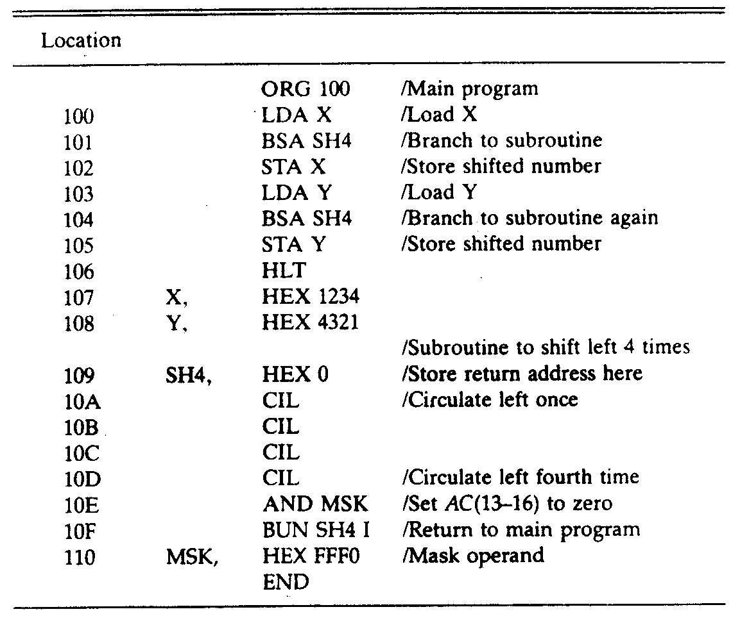

Slide 96
Subroutine Parameters and Data Linkage
The accumulator is generally used for a single input parameter and a single output parameter. More parameters can be transferred this way, in computers with multiple processor registers. Another method to transfer data to a subroutine is through the memory. Data are often placed in memory locations following the call. They can also be placed in a block of storage. The first address of the block is then placed in the memory location following the call. In any case, the return address always gives the link information for transferring data between the main program and the subroutine.

Slide 97
Program to Demonstrate Parameter Linkage

Slide 98
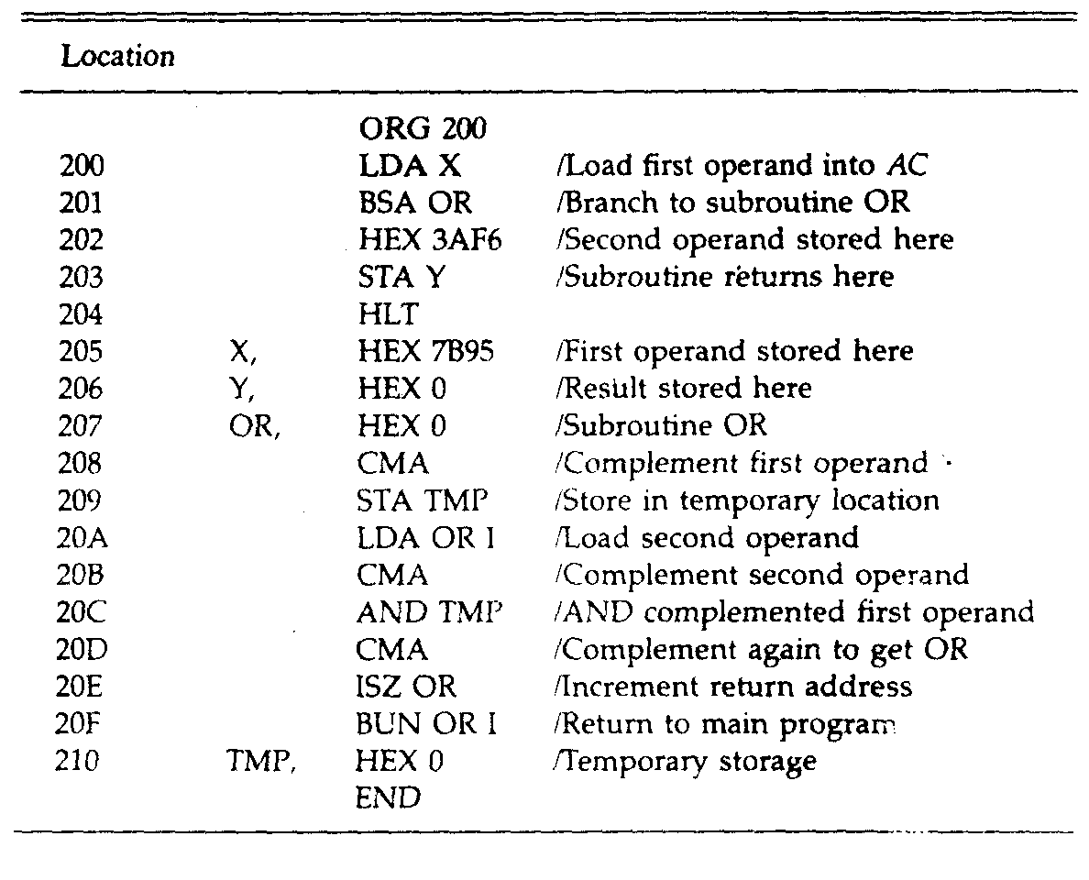

Slide 99
SESSION:12
Inputs/Outputs Programming
Microprogrammed Control
Control Memory
Address Sequencing
Microprogram Example
Design Control Unit

Slide 100
Input-Output Programming
When we write programs we use the symbols that are defined by programming language. The symbols in a language are strings of characters and each character is assigned an 8-bit code in order to store it in computer memory. A binary-coded character enters the computer when an INP (input) instruction is executed. A binary-coded character is transferred to the output device when an OUT (output) instruction is executed. The output device detects the binary code and types the corresponding character.

Slide 101
Programs to Input and Output One Character

Slide 102
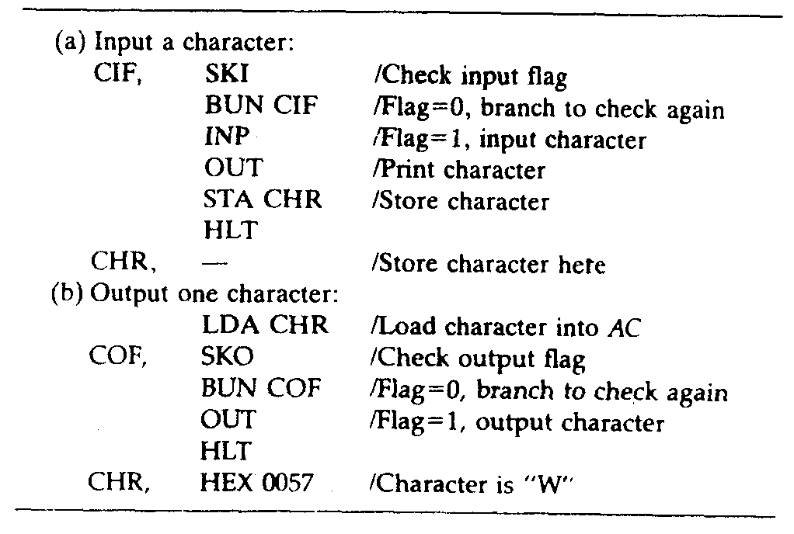

Slide 103
Control Memory
A memory that is part of a control unit is called a control memory.
A computer that uses a microprogrammed control unit usually has two separate memories - a main memory and a control memory. The main memory is available to the user for storing their programs. The contents of main memory may change when the data are manipulated and every time the program is changed.

Slide 104
Address Sequencing
When power is turned on in the computer, an initial address is loaded into the control address register. This address is the address of the first microinstruction that activates the instruction fetch routine. The fetch routine may be sequenced by incrementing the control address register through the rest of its microinstructions. At the end of the fetch routine, the instruction is in the instruction register of the computer.

Slide 105
Conditional Branching
. The status conditions are special bits that give parameter information, for example, the carry out of an adder, the sign bit of a number, the mode bits of an instruction, and input or output status conditions. Information in these bits can be tested and actions initiated based on their condition whether their value is 1 or 0. The status bits, together with the field in the microinstruction
that specifies a branch address, control the conditional branch decisions generated in the branch logic.

Slide 106
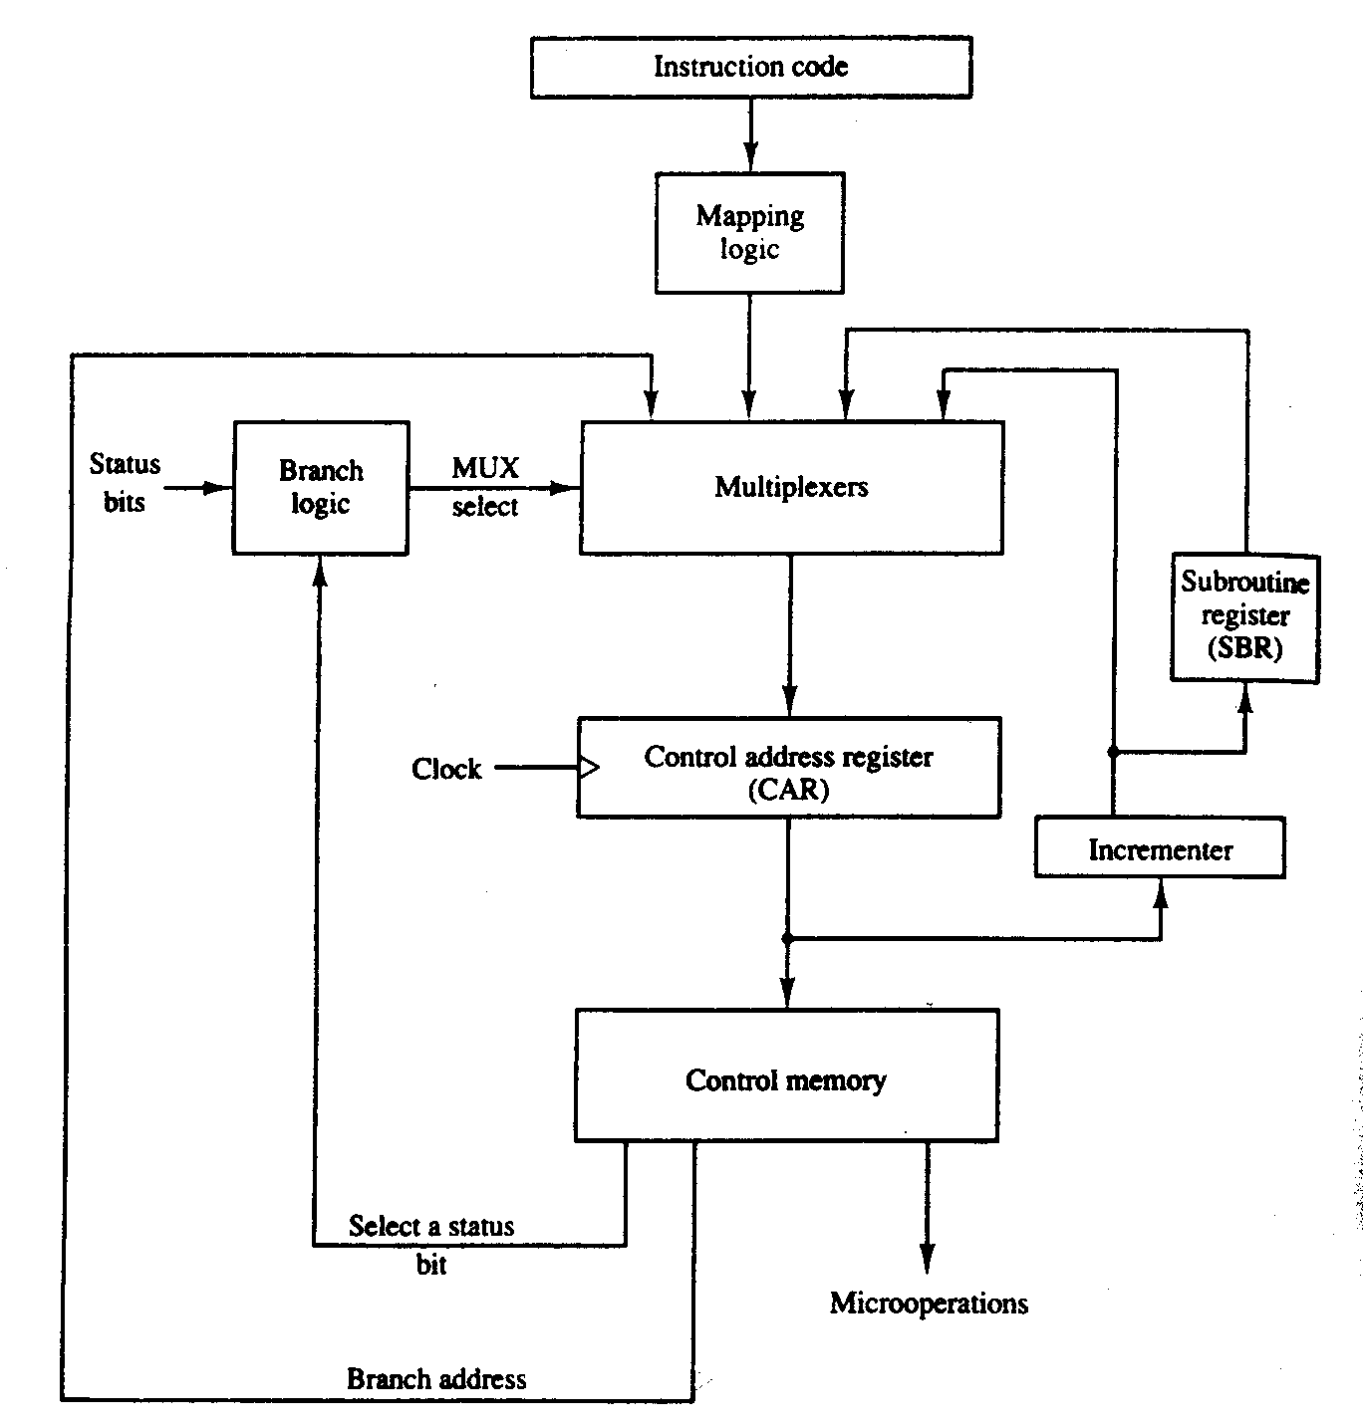

Slide 107
Mapping of Instruction
The status bits for this type of branch are the bits in the operation code part of the instruction.

Slide 108
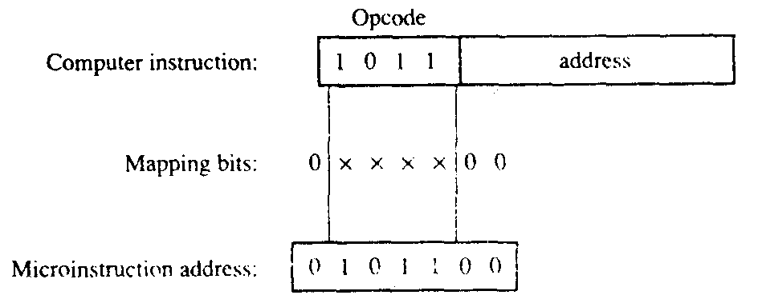

Slide 109
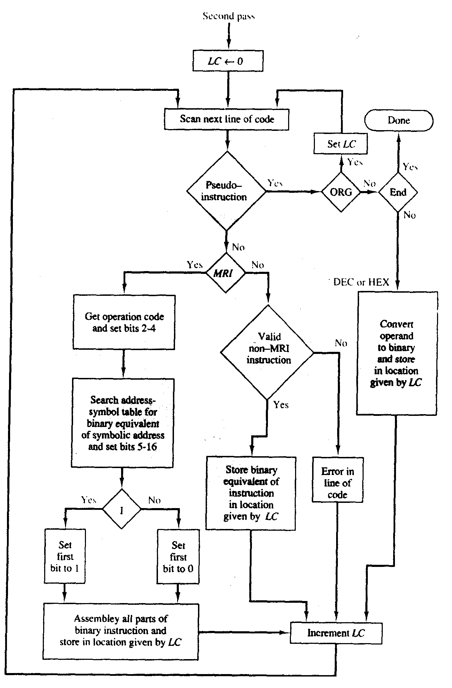

Slide 110
Unit 5
Central Processing Unit

Slide 111
Chapter: 5

Slide 112
Central Processing Unit
General Register Organization
Stack Organization
Instruction Formats
Addressing Modes
Data Transfer and Manipulation
Program Control
Reduced Instruction Set Computer
Pipeline and Vector Processing
Parallel Processing

Slide 113
Pipelining
Arithmetic Pipeline
RISC Pipeline
Vector Processing
Arrays Processors

Slide 114
SESSION:13
Central Processing Unit
General Register Organization
Stack Organization
Instruction Formats
Addressing Modes
Data Transfer and Manipulation

Slide 115
Central Processing Unit
The Central Processing Unit (CPU) is called the brain of the computer that performs data-processing operations. Figure 5.1 shows the three major parts of CPU.

Slide 116
Major Components of CPU
Intermediate data is stored in the register set during the execution of the instructions. The microoperations required for executing the instructions are performed by the arithmetic logic unit whereas the control unit takes care of transfer of information among the registers and guides the ALU. The control unit services the transfer of information among the registers and instructs the ALU about which operation is to be performed. The computer instruction set is meant for providing the specifications for the design of the CPU. The design of the CPU largely, involves choosing the hardware for implementing the machine instructions.

Slide 117
General Register Organization
The need for memory locations arises for storing pointers, counters, return address, temporary results and partial products. Memory access consumes the most of the time off an operation in a computer. It is more convenient and more efficient to store these intermediate values in processor registers. A common bus system is employed to contact registers that are included in the CPU in a large number. Communications between registers is not only for direct data transfer but also for performing various micro-operations.

Slide 118
Stack Organization
The CPU of most computers comprises of a stack or last-in-first-out (LIFO) list wherein information is stored in such a manner that the item stored last is the first to be retrieved. The operation of a stack can be compared to a stack of trays. The last tray placed on top of the stack is the first to be taken off.
A stack has only two operations i.e. the insertion and deletion of items. The operation insertion is called push (or push-down) because it can be thought of as the result of pushing a new item on top. The deletion operation is called pop (or pop-up) because it can be thought of as the result of removing one item so that the stack pops up. In actual, nothing is exactly pushed or popped in a computer stack. These operations are simulated by incrementing or decrementing the stack pointer register.

Slide 119
Register Stack
There are two ways to place a stack. Either it can be placed in a portion of a large memory or it can be organized as a collection of a finite number of memory words or registers.
In a 64-word stack, the stack pointer contains 6 bits because 2⁶ = 64. Since SP has only six bits, it cannot exceed a number greater than 63 (111111 in binary). When 63 is incremented by l, the result is 0 since 111111 + 1 = 1000000 in binary, but SP can accommodate only the six least significant bits. Similarly, when 000000 is decremented by 1, the result is 111111. The 1-bit register FULL is set to 1 when the stack is full, and the one-bit register EMTY is set to 1 when the stack is empty of items. DR is the data register that holds the binary data to be written into or read out of the stack.

Slide 120
Memory Stack
The implementation of a stack in the CPU is done by assigning a portion of memory. A portion of memory is assigned to a stack operation and a processor register is used as a stack pointer to execute stack in the CPU. A portion of computer memory partitioned into three segments - program, data, and stack. The address of the next instruction in the program is located by the program counter PC while an array of data is pointed by address register AR. The top of the stack is located by the stack pointer SP.

Slide 121
Instruction Formats
The reference manuals provided with a computer system contain a description of its physical and logical structure. These manuals explain the internal construction of the CPU, including the processor registers available and their logical capabilities. All hardware-implemented instructions, their binary code format, and a precise definition of each instruction is very well described by these manuals. Given the fact that a computer has a variety of instruction code formats, it is the control unit within the CPU that interprets each instruction code and provides the necessary control functions needed to process the instruction.

Slide 122
The most common fields found in instruction formats are:
An operation code field that specifies the operation to be performed.
An address field that designates a memory address or a processor register.
A mode field that specifies the way the operand or the effective address is determined.

Slide 123
Instructions in computers can be of different lengths containing varying number of addresses. The internal organization of the registers of a computer determines the number of address fields in the instruction formats.. Most computers fall into one of three types of CPU organizations:
Single accumulator organization.
General register organization.
Stack organization.

Slide 124
Three-Address Instructions
Computers with three-address instruction formats can use each address field to specify either a processor register or a memory operand. The program in assembly language that evaluates X = (A + B) * (C + D) is shown below, together with comments that explain the register transfer operation of each instruction.

Slide 125
ADD R1,A,B R1←M[A]+M[B]
ADD R2,C,D R2←M[C]+M[D]
MUL X,R1,R2 M[X] ←R1*R2

Slide 126
Two-Address Instructions
Two-address instructions are the most common in commercial computers. Here again each address field can specify either a processor register or memory word. The program to evaluate X = (A + B)* (C + D) is as follows:
MOV R1, A R1←M[A]
ADD R1, B R1←RI+M[B]
MOV R2, C R2←M[C]
ADD R2,D R2←R2+M[D]
MUL R1,R2 R1←R1*RP
MOV X, R1 M[X] ← R1

Slide 127
One-Address Instructions
One-address instructions use an implied accumulator (AC) register for all data manipulation. For multiplication and division there is a need for a second register. However, here we will neglect the second register and assume that the AC contains the result of all operations. The program to evaluate X=(A+B)*(C+D)is:

Slide 128
LOAD A AC←M[A]
ADD B AC←AC+M[B]
STORE T M[T] ← AC
LOAD C AC ← M[C]
ADD D,A AC←AC+M[D]
MUL T AC←AC * M[T]
STORE X M[X] ←AC
All operations are done between the AC register and a memory operand. T is the address of a temporary memory location required for storing the intermediate result.

Slide 129
Zero-Address Instructions
A stack-organized computer does not use an address field for the instructions ADD and MUL. The PUSH and POP instructions, however, need an address field to specify the operand that communicates with the stack. The following program shows how X = (A + B) * (C + D) will be written for a stack organized computer. (TOS stands for top of stack.)

Slide 130
PUSH A TOS←A
PUSH B TOS←B
ADD T TOS← (A+B)
PUSH C TOS←C
PUSH D TOS←D
ADD T TOS← (C+D)
MDL T TOS← (C+D)*(A+B)
POP X M[X] ←TOS

Slide 131
RISC Instructions
The instruction set of a typical RISC processor is restricted/to the use of load and store instructions when communicating between memory and CPU. All other instructions are executed within the registers of the CPU without referring to memory. A program for a RISC-type CPU consists of LOAD and STORE instructions that have one memory and one. Register address, and computational-type instructions that have three addresses with all three specifying processor registers. The following is a program to evaluate X = (A + B)*(C + D).

Slide 132
LOAD R1, A R1← M[A]
LOAD R2, B R2 ← M[B]
LOAD R3, C R3 ← M[C]
LOAD R4, C R4 ← M[D]
ADD R1, R1, R2 R1 ← R1 + R2
ADD R3, R3, R2 R3 ← R3 + R4
MUL R1, R1, R3 R1 ← R1*R3
STORE X, R1 M[X] ← R1

Slide 133
The load instructions transfer the operands from memory to CPU registers. The add and multiply operations are executed with data in the registers without accessing memory. The result of the computations is then stored in memory with a store instruction.

Slide 134
Addressing Modes
As described the earlier, the operation to be performed is specified by the operation field of the instruction. The execution of the operation is performed on some data stored in computer registers or memory words. The way the operands are chosen during program. Selection of operands during program execution depends on the addressing mode of the instruction. The addressing mode specifies a rule for interpreting or modifying the address field of the instruction before the operand is actually referred. The purpose of using address mode techniques by the computer is to accommodate one or both of the following provisions:

Slide 135
To give programming versatility to the user by providing such facilities as pointers to memory, counters for loop control, indexing of data, and program relocation.
To reduce the number of bits in the addressing field of the instruction.

Slide 136
Usage of addressing modes lends programming versatility to the user and helps to write program data mode affection in terms of instruction and implementation. The basic operation cycle of the computer must be understood to have a thorough knowledge of addressing modes. The instruction cycle is executive in the control unit of the computer and is divided into three principal phases:

Slide 137
Fetch the instruction from memory.
Decode the instruction.
Execute the instruction.

Slide 138
Autoincrement or Autodecrement Mode: After execution of every instruction from the data in memory it is necessary to increment or decrement the register. This is done by using the increment or decrement instruction. Given upon its sheer necessity some computers use special mode that increments or decrements the content of the registers automatically.

Slide 139
Direct Address Mode: In this mode the operand resides in memory and its address is given directly by the address field of the instruction such that the affective address is equal to the address part of the instruction.

Slide 140
Indirect Address Mode: Unlike direct address mode, in this mode give the address field give the address where the effective address is stored in memory. The instruction from memory is fetched through control to read is address part to access memory again to read the effective address. A few addressing modes require that the address field of the instruction be added to the content of a specific register in the CPU. The effective address in these modes is obtained from the following equation:

Slide 141
Data Transfer and Manipulation
Computers are a boon to mankind when its come to carrying out various computational tasks, for they provide an extensive set of instructions to give the user the flexibility to perform these tasks. The basic difference between the instruction set of various computers is the way the operands are determined from the address and mode fields. But there are certain basic operations that are included in the instructions set every computer. Such a basic set of operation available in a typical computer can be classified in the three categories:

Slide 142
Data transfer instructions.
Data manipulation instructions.
Program control instructions.

Slide 143
Data Transfer Instructions
As the name suggests data transfer instructions are meant for transfer for data from one location to another, keeping the binary information intact. The useful transfer are between memory and processing registers, between processor registers and input or output, and between the processor registers themselves. Each instruction is accompanied with the mnemonic symbol which are different in different computers for the same instruction name.

Slide 144
To distinguish with between the various address modes, the mnemonic symbol are modified by assembly language conventions. For instance, the mnemonic for load immediate becomes LDI. Other assembly language conventions use a special character to designate the addressing mode. For example, the immediate mode is recognized from a pound sign # placed before the operand. What ever may be the case, the important thing is to realize that each instruction can occur with a variety of addressing modes.

Slide 145
Data Manipulation Instructions
Data manipulation instructions are those that perform operations on data and are a help in computation done on computers provide the computational capabilities for the computer.
Arithmetic instructions.
Logical and bit manipulation instructions.
Shift instructions.

Slide 146
Arithmetic Instructions
The four basic arithmetic operations are addition, subtraction, multiplication, and division. Most of the computers carry instructions for all four operations. For computers which have only addition and possibly subtraction instructions, the other two operations i.e. multiplication and division must be generated by means of software subroutines. These four basic arithmetic operations are adequate for providing solutions to scientific problems when expressed in terms of numerical analysis methods.

Slide 147
Logical and Bit Manipulation Instructions
Logical instructions are useful for performing binary operations on strings of bits stored in registers. These instructions consider each bit of the operand individually and treat it as a Boolean variable. Their proper application facilitates changing in bit values, clearing or inserting new bit values into operands stored in registers or memory words.

Slide 148
Shift Instructions
Shift instructions are used to shift the content of an operand from left to right our vice-a-versa. The bit shifted in at the end of the word determines the type of shift used. Any of the logical shifts, arithmetic shifts, or rotate-type operations can be specified by shift instruction. In any case the shift may be to the right or to the left.

Slide 149
Four types of shift instructions . The logical shift inserts 0 to the end bit position. The end position is the leftmost bit for shift right and the rightmost bit position for the shift left. Arithmetic shifts are used in conformity with the rules for signed-2’s complement numbers. As a rule the arithmetic shift-right instruction must preserve the sign bit in the leftmost position. The sign bit is shifted to the right together with the rest of the number, but the sign bit itself remains unaltered. This is a shift-right operation wherein the end bit remains unchanged the same. The arithmetic shift-left instruction inserts 0 to the end position and is identical to the logical shift-left instruction. For this reason many computers do not provide a distinct arithmetic shift-left instruction when the logical shift-left instruction is already available.

Slide 150
SESSION:14
Program Control
Reduced Instruction Set Computer
Pipeline and Vector Processing
Parallel Processing

Slide 151
Micro Programmed Control
Memory locations are storage house for instructions. When processed in the CPU, the instructions are fetched from consecutive memory locations and implemented. Each time an instruction is fetched from memory, the program counter is simultaneously incremented with the address of the next instruction in sequence. Once a data transfer or data manipulation instruction is executed, control returns to the fetch cycle with the program counter containing the address of the instruction next in sequence. In case of a program control type of instruction execution of instruction may change the address value in the program counter and cause the flow of control to be altered.

Slide 152
Branch and jump instructions may be conditional or unconditional. An unconditional branch instruction, as a name denotes, causes a branch to the specified address without any conditions. On the contrary the conditional branch instruction specifies a condition such as branch if positive or branch if zero. If the condition is met, the program counter is loaded with the branch address and the next instruction is taken from this address. If the condition is not met, the program counter remains unaltered and the next instruction is taken from the next location in sequence.

Slide 153
The four status bits are symbolized by C, S, Z, and V. The bits are set or cleared as a result of an operation performed in the ALU.
Bit C (carry) is set to 1 if the end carry C8 is 1 .It is cleared to 0 if the carry is 0.
Bit S (sign) is set to 1 if the highest-order bit F7 is 1. It is set to 0 if the bit is 0.
Bit Z (zero) is set to 1 if the output of the ALU contains all 0’s. It is cleared to 0 otherwise. In other words, Z = 1 if the output is zero and Z = 0 if the output is not zero.

Slide 154
Conditional Branch Instructions
The commonly used branch instructions are listed below in Table 5.10. Each mnemonic is constructed with the letter B (for branch) and an abbreviation of the condition name. When the opposite condition state is used, the letter N (for no) is inserted to define the 0 state. Thus BC is Branch on Carry, and BNC is Branch on No Carry. If the stated condition is met, the address specified by the instruction receives program control. If not, control continues with the instruction that follows. The conditional instructions can be associated also with the jump, skip, call, or return type of program control instructions. The zero status bit is employed for testing if the result of an ALU operation is equal to zero or not. The carry bit is employed to check if there is a carry out of the most significant bit position of the ALU. It is also used in conjunction with the rotate instructions to check the bit shifted from the end position of a register into the carry position. The sign bit reflects the state of the most significant bit of the output from the ALU. S = 0 denotes a positive sign and S = 1, a negative sign. Therefore, a branch on plus checks for a sign bit of 0 and a branch on minus checks for a sign bit of 1. It is worth noticeable that these two conditional branch instructions can be used to check the value of the most significant bit whether it represents a sign or not. The overflow bit is used in conjunction with arithmetic operations done on signed numbers in 2's complement representation.

Slide 155
Reduced Instruction Set Computer
The design of the instruction set for the processor is very important in terms of computer architecture. It’s the instruction set of a particular computer that determines the way that machine language programs are constructed. Computer hardware is improvised by various factors, such as upgrading existing models to provide more customer applications adding instructions that facilitate the translation from high-level language into machine language programs and striving to develop machines that move functions from software implementation into hardware implementation. A computer with a large number of instructions is classified as a complex instruction set computer, abbreviated as CISC.

Slide 156
In the developing years, computers designer felt the needs of computers that use fewer instructions with simple constructs so they can be executed much faster within the CPU without having to use memory as often. This type of computer is classified as a reduced instruction set computer or RISC.The design of an instruction set for a computer depends on not only machine language constructs,but also on the requirements imposed on the use of high-level programming languages. A compiler program translate high level languages to machine language programs. The basic reason to a design a complex instruction set is the need to simplify the compilation and enhance the overall computer efficiency. The essential goal of a CISC architecture is to attempt to provide a single machine instruction for each statement that is written in a high-level language.

Slide 157
RISC Characteristics
The essential goal of RISC architecture involves an attempt to reduce execution time by simplifying the instruction set of the computer. The major characteristics of a RISC processor are:
Relatively few instructions.
Relatively few addressing modes.
Memory access limited to load and store instructions.
All operations done within the registers of the CPU

Slide 158
Fixed length easily decoded instruction format.
Single-cycle instruction execution.
Hardwired rather than microprogrammed control.

Slide 159
Parallel Processing
Parallel processing denotes a large class of techniques that are used to deliver simultaneous data-processing tasks to enhance the computational speed of a computer system. A parallel processing system performs concurrent data processing to achieve faster execution time unlike the conventional computer where in each instruction is processed sequentially. For example, while an instruction is being executed in the ALU, the next instruction can execute two or more instructions at the same time. Furthermore, the system may have two or more processors operating concurrently. The goal of parallel processing is anciently to speed up the computer processing capability and increase it throughout, that is, the amount of processing that can be achieved during a given interval of time. Parallel processing, demands for an increase in hardware and that raises the cost of the system. However, technological developments have cut down hardware costs to the level where parallel processing techniques have become economical.

Slide 160
One possible way of separating the execution unit into eight functional units operating in parallel. Depending upon the operations specified by the instruction associated with the operands, the operands, those in registers are applied to the one of the units. The operation performed in each functional unit is indicated in each block of the diagram. The adder and integer multiplier perform the arithmetic operations with integer numbers. The floating-point operations are separated into three circuits operating in parallel. The logic, shift, and increment operations can be performed concurrently on different data. All units are independent of each other; so one number can be shifted while another number is being incremented. A multifunctional organization is usually associated with a complex control unit to coordinate all the activities among the various components.

Slide 161
Flynn's classification divides computers into four major groups as follows:
Single instruction stream, single data stream (SISD)
Single instruction stream, multiple data stream (SIMD)
Multiple instruction stream, single data stream (MISD)
Multiple instruction stream, multiple data stream (MIMD)

Slide 162
SESSION:15
Pipelining
Arithmetic Pipeline
RISC Pipeline
Vector Processing
Arrays Processors

Slide 163
Pipelining
Pipelining is a technique wherein a sequential process is disintegrated into sub operations, with each sub process being executed in a special dedicated segment that operates concurrently with all other segments. A pipeline can be visualized as a collection of processing segments acting as a channel for binary information flow. Each segment performs partial processing dictated by the way the task is segregated. The result obtained from the computation in each segment is transferred to the next segment in the pipeline. The first result is obtained after the data have passed through all segments.

Slide 164
Arithmetic Pipeline
Arithmetic pipelines are employed to implement floating-point operations, multiplication of fixed-point numbers, and similar computations encountered in scientific problems. A pipeline multiplier is essentially an array multiplier with special adders designed to minimize the carry propagation time through the partial products. Floating-point operations are easily decomposed into suboperations. We will now show an example of a pipeline unit for floating-point addition and subtraction.

Slide 165
Instruction Pipeline
Pipeline processing appear both in the data stream and in the instruction stream. An instruction pipeline reads consecutive instructions from memory. While previous instructions are processed in other segments, an instruction pipeline read consecutive instruction from memory. This causes overlapping of fetch and execute face and performance of simultaneous operations. One possible digression associated with such a scheme is that an instruction may cause a branch out of sequence. When this happens the pipeline must be cleared and all the instructions that have been read from memory after the branch instruction must be discarded.

Slide 166
RISC Pipeline
The reduced instruction set computer (RISC) was introduced earlier in this unit. One of the unique features of risk RISC is its ability to implement an instruction pipeline using a small number of suboperations, with each being executed in one clock cycle. Because of the fixed-length instruction format, the decoding of the operation can occur with the register selection simultaneously. All data manipulation instructions have register-to-register operations. Since all operands are in registers, the need for calculating an effective address or fetching of operands from memory does not arise. The instruction pipeline can be implemented with two or three segments. One segment fetches the instruction from program memory, and the other segment executes the instruction in the ALU. A third segment may be used to store the result of the ALU operation in a destination register.

Slide 167
Vector Processing
There are certain computational problems that can not be resolved by a are beyond the capabilities of a conventional computer on the basis of the fact that they require a vast number of computations that will take a conventional computer days or even weeks to complete. In many science and engineering applications, the problems can be formulated in terms of vectors and matrices that tend themselves to vector processing. Computers with vector processing capabilities are very much required in specialized applications. The following are representative application areas where vector processing is of the utmost importance:

Slide 168
Long-range weather forecasting
Petroleum explorations
Seismic data analysis
Medical diagnosis
Aerodynamics and space flight simulations
Artificial intelligence and expert systems
Mapping the human genome
Image processing

Slide 169
Vector and parallel processing techniques should be applied to achieve result of high performance in case of unavailability of complex computers to speed up the execution time of instructions.

Slide 170
Array Processes
An array processor is a processor that is employed to compute on large arrays of data. The term is used to refer to two different types of processors. An attached array processor is an auxiliary processor attached to a general purpose computer with the sole purpose of an hence performance of the host computer in specific numerical computation tasks.

Slide 171
Unit 6

Slide 172
Computer Arithmetic and Input-Output Organization
Computer Arithmetic
Addition and Subtraction
Multiplication Algorithms
Division Algorithms
Floating Point Arithmetic Operations
Decimal Arithmetic Unit
Decimal Arithmetic operations
Peripheral Devices
Input Output Interface

Slide 173
Asynchronous Data Transfer
Asynchronous Data Transfer
Modes of Transfer
Priority Interrupt
Direct Memory Access
Input Output Processors (IOP)
Serial Communication
Multiprocessors and their characteristics
Interconnection Structures
Interproces Arbitration

Slide 174
Interprocessor communication and Sychronisation
Cache Coherence

Slide 175
SESSION:16
Computer Arithmetic
Addition and Subtraction
Multiplication Algorithms
Division Algorithms
Floating Point Arithmetic Operations
Decimal Arithmetic Unit

Slide 176
Computer Arithmetic
To execute arithmetic operations there is a separate section called arithmetic processing unit in central processing unit. The arithmetic instructions are performed generally on binary or decimal data. Fixed-point numbers are used to represent integers or fractions. We can have signed or unsigned negative numbers. Fixed-point addition is the simplest arithmetic operation.

Slide 177
Addition and Subscription
We showed that the adopted representation for negative numbers refers to the representation of number of the registers before and after the execution of the arithmetic operation. It does not imply that we cannot use complement arithmetic in an intermediate step.

Slide 178
Addition and Subtraction with Signed –Magnitude Data
The algorithms for addition and subtraction are derived from the table and can be stated as follows (the words parentheses should be used for the subtraction algorithm).
Addition and Subtraction of Signed-Magnitude Numbers

Slide 179
Operation
Add Magnitudes
Subtract Magnitudes
When A > B
When A < B
When A = B
(+A) + (+B)
+(A + B)
(+A) + (– B)
+ (A – B)
– (B – A)
+ (A – B)
(– A) + (+ B)
– (A – B)
+ (B – A)
+ (A – B)
(– A) + (– B)
– (A + B)
(+ A) – (+ B)
+ (A + B)
– (B – B)
+ (A – B)
(+ A) – (– B)
+ (A + B)
(–A) – (+B)
– (A + B)
(–A) – (–B)
– (A – B)
+ (B – A)
+ (A – B)

Slide 180
Addition and Subtraction with Signed-2's Complement Data
The addition of two numbers in signed 2's complement form by adding the numbers with the sign bits treated the same as the other bits of the number. We discard the carry of the sign-bit position. The subtraction consists of first taking the 2's complement of the subtrahend and then adding it to the minuend.

Slide 181
If we compare this algorithm with its signed-magnitude part, we note that it is much simpler to add and subtract numbers if we keesp negative numbers in signed 2's complement representation. Therefore most computers adopt this representation over the more familiar signed-magnitude.

Slide 182
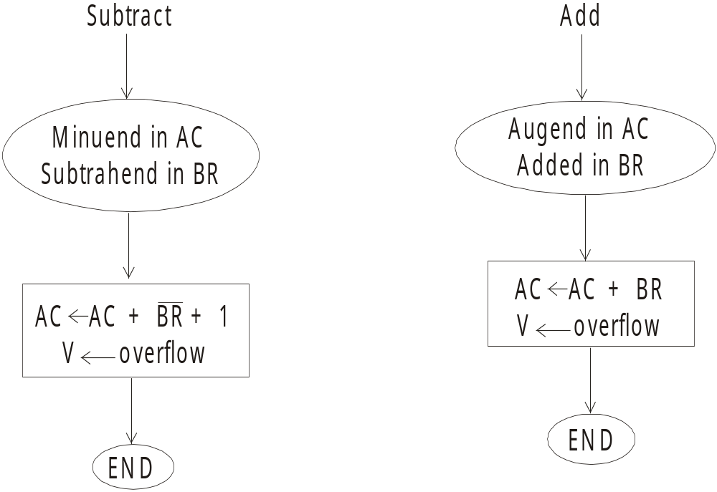

Slide 183
Multiplication Algorithms
Multiplication of two fixed-point binary numbers in signed magnitude representation is done with paper and pencil by a process of successive shift and add operations. This process is best illustrated with a numerical example:
23 10111 Multiplicand
19 x 10011 Multiplier
10111
10111
00000
00000
10111
437 110110101 Product

Slide 184
Booth Multiplication Algorithm
If the numbers are represented in signed 2’s complement then we can multiply them by using Booth algorithm. In fact the strings of 0's in the multiplier need no addition but just shifting, and a string of l's in the multiplier from bit weight 2^{k} to weight 2^{m} can be treated as 2^{k+1} - 2^{m}. For example, the binary number 001111 (+15) has a string of 1's from 2³ to 2⁰(k = 3, m = 0).

Slide 185
Array Multiplier
To check the bits of the multiplier one at a time and forming partial products is a sequential operation requiring a sequence of add and shift micro-operations. The multiplication of two binary numbers can be done with one micro-operation by using combinational circuit that forms the product bits all at once.

Slide 186
A combinational circuit binary multiplier with more bits can be constructed in a similar fashion. A bit of the multiplier is ANDed with each bit of the multiplicand in as many levels as there are bits in the multiplier. The binary output in each level AND gates is added in parallel with the partial product of the previous level to form a new partial product. The last level produces the product. For j multiplier bits and k multiplicand bits we need j * k AND gates and (j – 1) k-bit adders to produce a product of j + k bits.

Slide 187
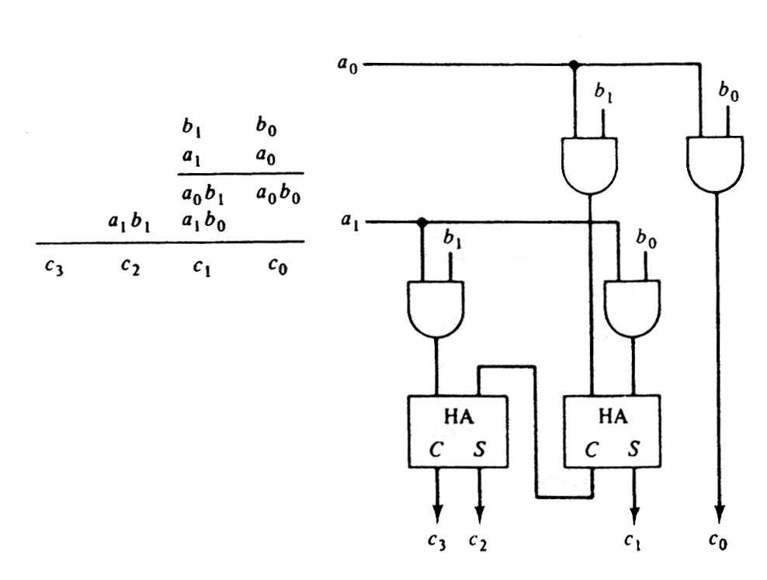

Slide 188
Division Algorithms
Division of two fixed-point binary numbers in signed magnitude representation is performed with paper and pencil by a process of successive compare, shift and subtract operations. Binary division is much simpler than decimal division because here the quotient digits are either 0 or 1 and there is no need to estimate how many times the dividend or partial remainder fits into the divisor.

Slide 189
B = 10001
11010
0111000000
01110
011100
- 10001
- 010110
- -10001
- - 001010
- - - 010100
- - - -10001
- - - -000110
- - - - -00110
Quotient = Q
Dividend = A
5 bits of A < B, quotient has 5 bits
6 bits of A ≥ B
Shift right B and subtract; enter 1 in Q
7 bits of remainder ≥ B
Shift right B and subtract; enter 1 in Q
Remainder < B; enter 0 in Q; shift right B
Remainder ≥ B
Shift right B and subtract; enter 1 in Q
Remainder < B; enter 0 in Q
Final remainder
Division:

Slide 190
Floating Point Numbers
In many high-level programming languages we have a facility for specifying floating-point numbers. The most common way is by a real declaration statement. High level programming languages must have a provision for handling floating-point arithmetic operations. The operations are generally built in the internal hardware. If no hardware is available, the compiler must be designed with a package of floating-point software subroutine. Although the hardware method is more expensive, it is much more efficient than the software method. Therefore, floating- point hardware is included in most computers and is omitted only in very small ones.

Slide 191
Basic Considerations
There are two part of a floating-point number in a computer - a mantissa m and an exponent e. The two parts represent a number generated from multiplying m times a radix r raised to the value of e. Thus m x r^{e}

Slide 192
The mantissa may be a fraction or an integer. The position of the radix point and the value of the radix r are not included in the registers. For example, assume a fraction representation and a radix 10. The decimal number 537.25 is represented in a register with m = 53725 and e = 3 and is interpreted to represent the floating-point number .53725 x 103
A floating-point number is said to be normalized if the most significant digit of the mantissa in nonzero. So the mantissa contains the maximum possible number of significant digits. We cannot normalize a zero because it does not have a nonzero digit. It is represented in floating-point by all 0’s in the mantissa and exponent.

Slide 193
Addition and Subtraction of Floating Point Numbers
During addition or subtraction, the two floating-point operands are kept in AC and BR. The sum or difference is formed in the AC. The algorithm can be divided into four consecutive parts:
1. Check for zeros.
2. Align the mantissas.
3. Add or subtract the mantissas
4. Normalize the result

Slide 194
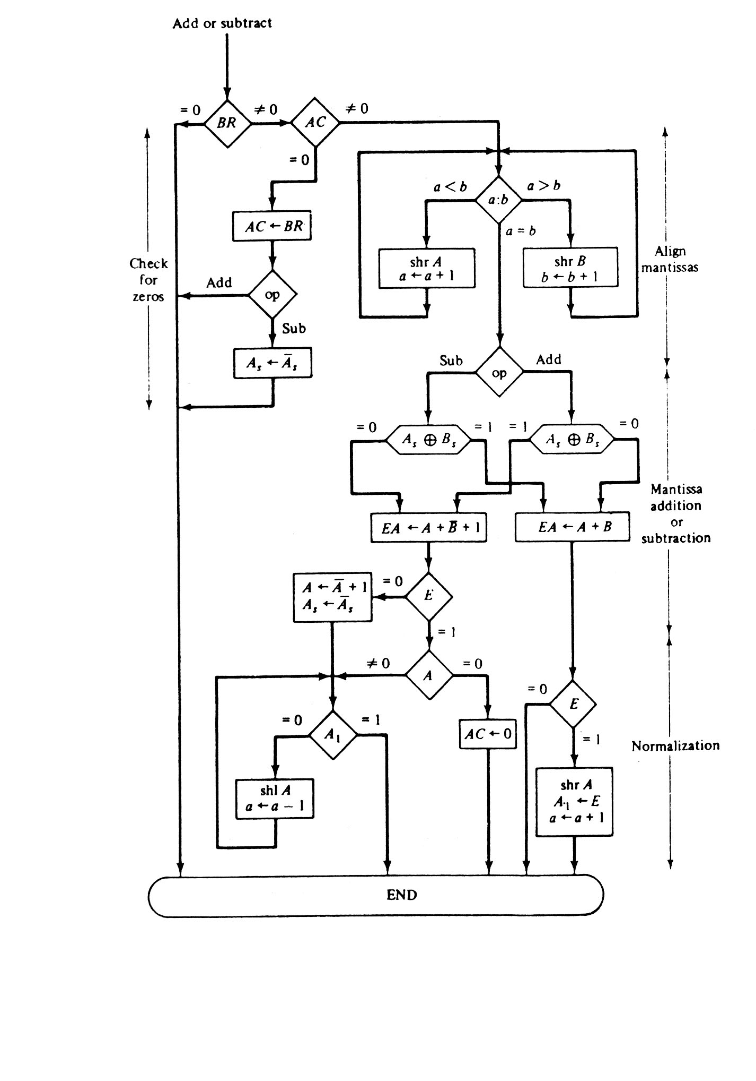

Slide 195
Multiplying Float Numbers
The multiplication of two floating-point numbers requires multiplying the mantissas and adding the exponents. There is no need of comparison of exponents or alignment of mantissas. The multiplication of the mantissas is done in the same way as in fixed-point to provide a double-precision product. The double-precision answer is used in fixed–point numbers to increase the accuracy of the product. In floating-point, the range of a single–precision combined with the exponent is usually accurate enough. So the half most significant bits of the mantissa product and the exponent are taken together to form a single-precision floating-point product.

Slide 196
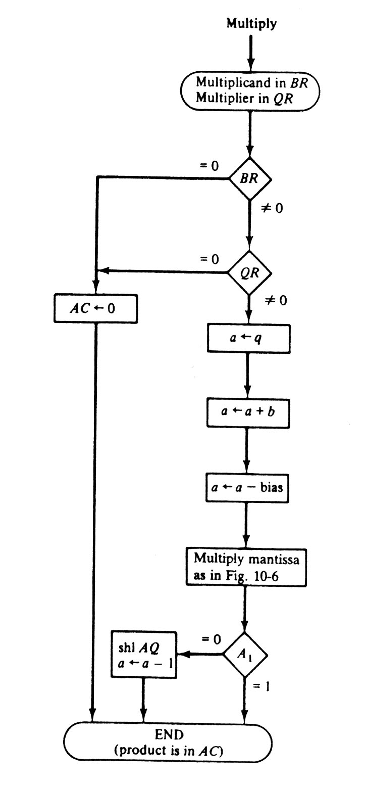

Slide 197
Floating Point Division
The division algorithm has five parts:
1.Check for zero.
2.Initialize registers and evaluate the sign
3.Align the dividend
4.Subtract the exponents
5.Divided the mantissas

Slide 198
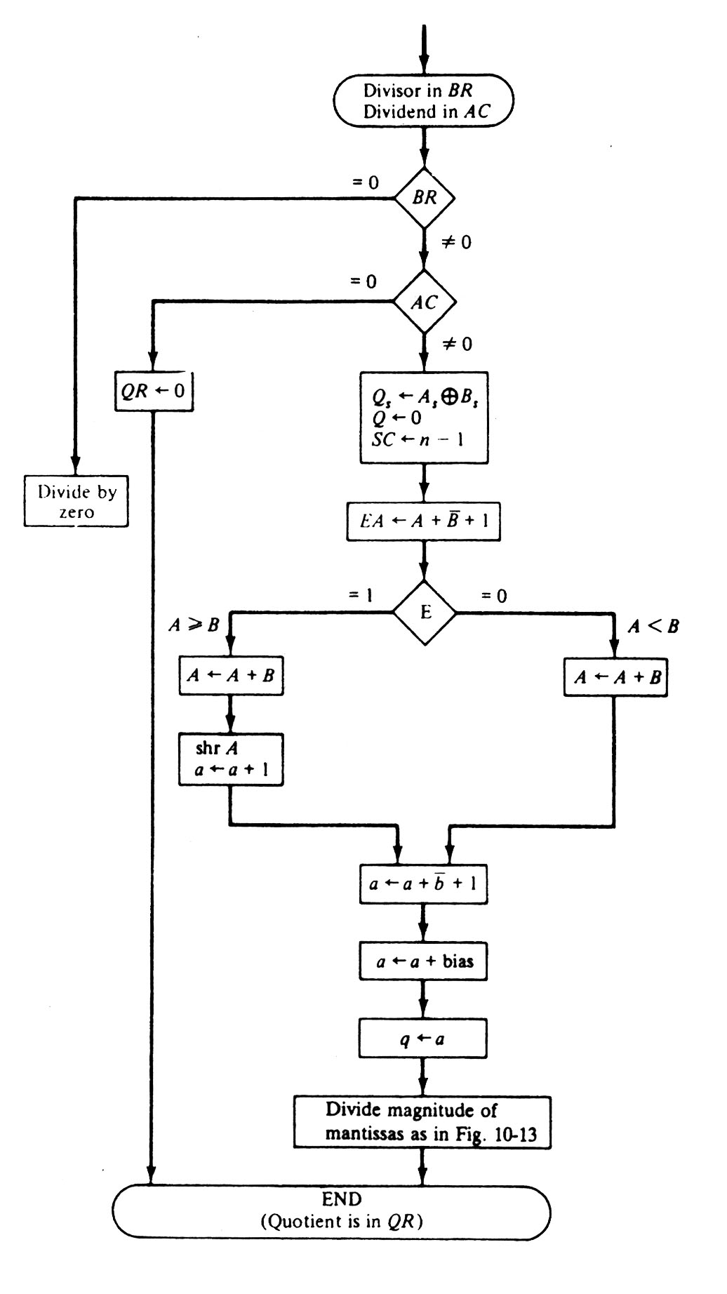

Slide 199
Decimal Arithmetic Unit
The user of a computer input data in decimal numbers and receives output in decimal form. But a CPU with an ALU can perform arithmetic micro-operations only on binary data. To perform arithmetic operations with decimal data, it is necessary to convert the input decimal numbers to binary, to perform all calculations with binary numbers, and to convert the results into decimal.

Slide 200
BCD Adder
The arithmetic addition of two decimal digits in BCD, with a possible carry from a previous stage. Since each input digit does not exceed 9, the output sum cannot be greater than 9 + 9 + 1 = 19, the 1 in the sum being an input-carry. Assume that we apply two BCD digits to a 4-bit binary adder. The adder will form the sum in binary and produce a result that may range from 0 to 19.

Slide 201
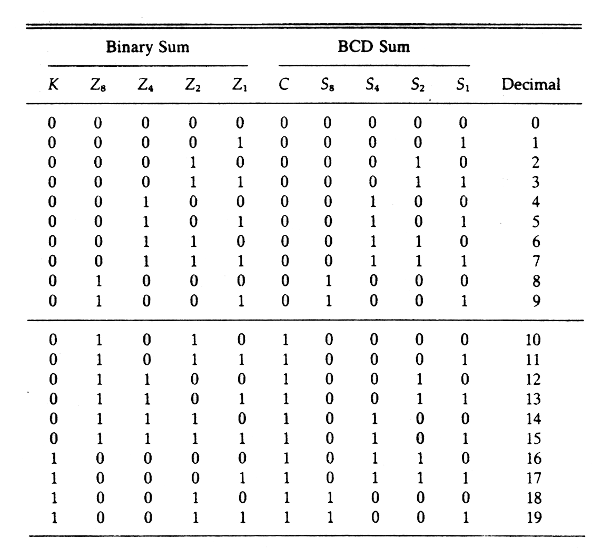

Slide 202
A BCD adder is circuit that adds two BCD digits in parallel and generates a sum digit also in BCD. ABCD adder must include the correction logic in its internal construction. To add 0110 to the binary sum, we use a second 4-bit binary adder. The two decimal digits, together with the input-carry, are first added in the top 4-bit binary adder to produce the binary sum. When the output-carry is equal to 0, nothing is added to the binary sum through the bottom 4-bit binary adder. The output-carry generated from the bottom binary adder may be ignored, since it supplies information already available in the output-carry terminal.

Slide 203
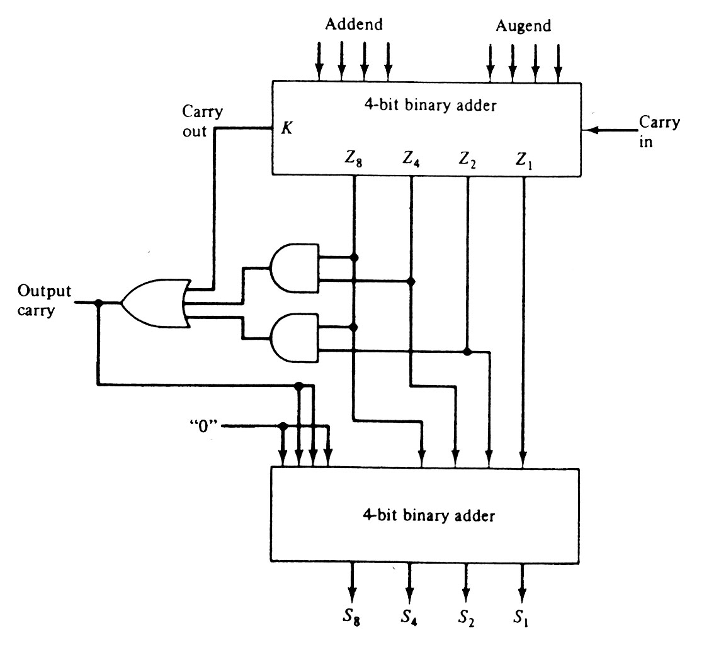

Slide 204
BCD Subtraction
Subtraction of two decimal numbers needs a subtractor circuit that is different from a BCD adder. We perform the subtraction by taking the 9’s or 10’s complement of the subtrahend and adding it to the minuend. Since the BCD is not a self-complementing code, we cannot obtain the 9’s complement by complementing each bit in the code. It must be formed using a circuit that subtracts each BCD digit from 9.

Slide 205
One stage of a decimal arithmetic unit that can be used to add or subtract two BCD digits is given in Fig. 6.18. It has of a BCD adder and a 9’s complementer. The mode M controls the operation of the unit. With M = 0, the S outputs form the sum of A and B. With M = 1, the S outputs form the sum of A plus the 9’s complement of B. For numbers with n decimal digits we need n such stages. The output carries C_{i}+1 from one stage. to subtract the two decimal numbers let M = 1 and apply a 1 to the input carry C₁ of the first stage. The outputs will form the sum of A plus the 10’s complement of B, which is equivalent to a subtraction operation if the carry-out of the last stage is discarded.

Slide 206
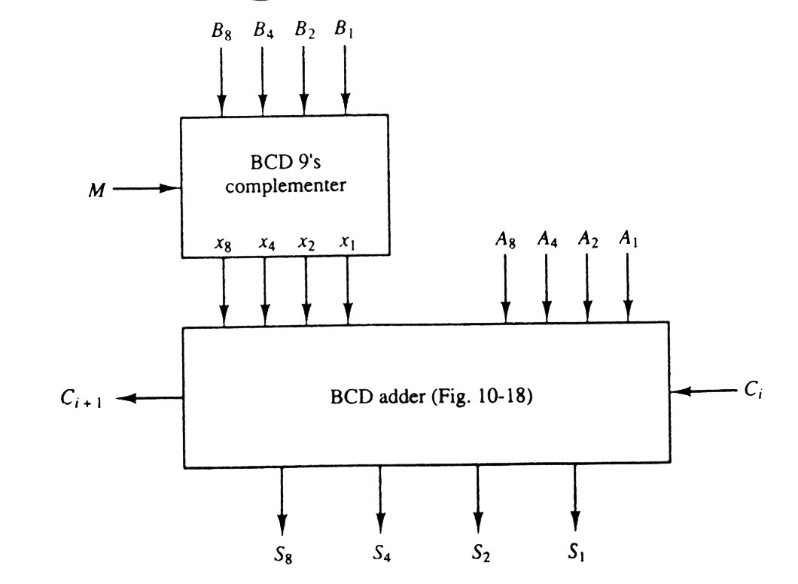

Slide 207
SESSION:17
Decimal Arithmetic operations
Peripheral Devices
Input Output Interface
Asynchronous Data Transfer
Asynchronous Data Transfer
Modes of Transfer

Slide 208
Decimal Arithmetic Operations
For arithmetic operations with decimal data are same as the algorithms for the binary data. In fact, except for a slight modification in the multiplication and division algorithms, we can use the same. Flowchart for both types of data provided that we interpret the micro-operation symbols properly. Decimal numbers in BCD are stored in computer registers in groups of four bits. Each 4-bit group represents a decimal digit and must be taken as a unit when performing decimal micro-operations.

Slide 209
Addition and Subtraction
The algorithm for addition and subtraction of binary signed-magnitude numbers can also be for decimal signed-magnitude numbers provided that we interpret the micro-operation symbols in the proper manner. Similarly, the algorithm for binary signed 2’s complement numbers can be used for decimal signed-10’s complement numbers. The binary data must use a binary adder and a complementer. The decimal data must use a decimal arithmetic unit capable of adding two BCD numbers and formatting the 9’s complement of the subtrahend

Slide 210
The parallel method is fast but needs a large number of adders. The digit-serial bit parallel method needs only one BCD adder, which is shared by all the digits. It is slower than the parallel method because of the time need to shift the digits. The all-serial method requires a minimum amount of equipment but is very slow.

Slide 211
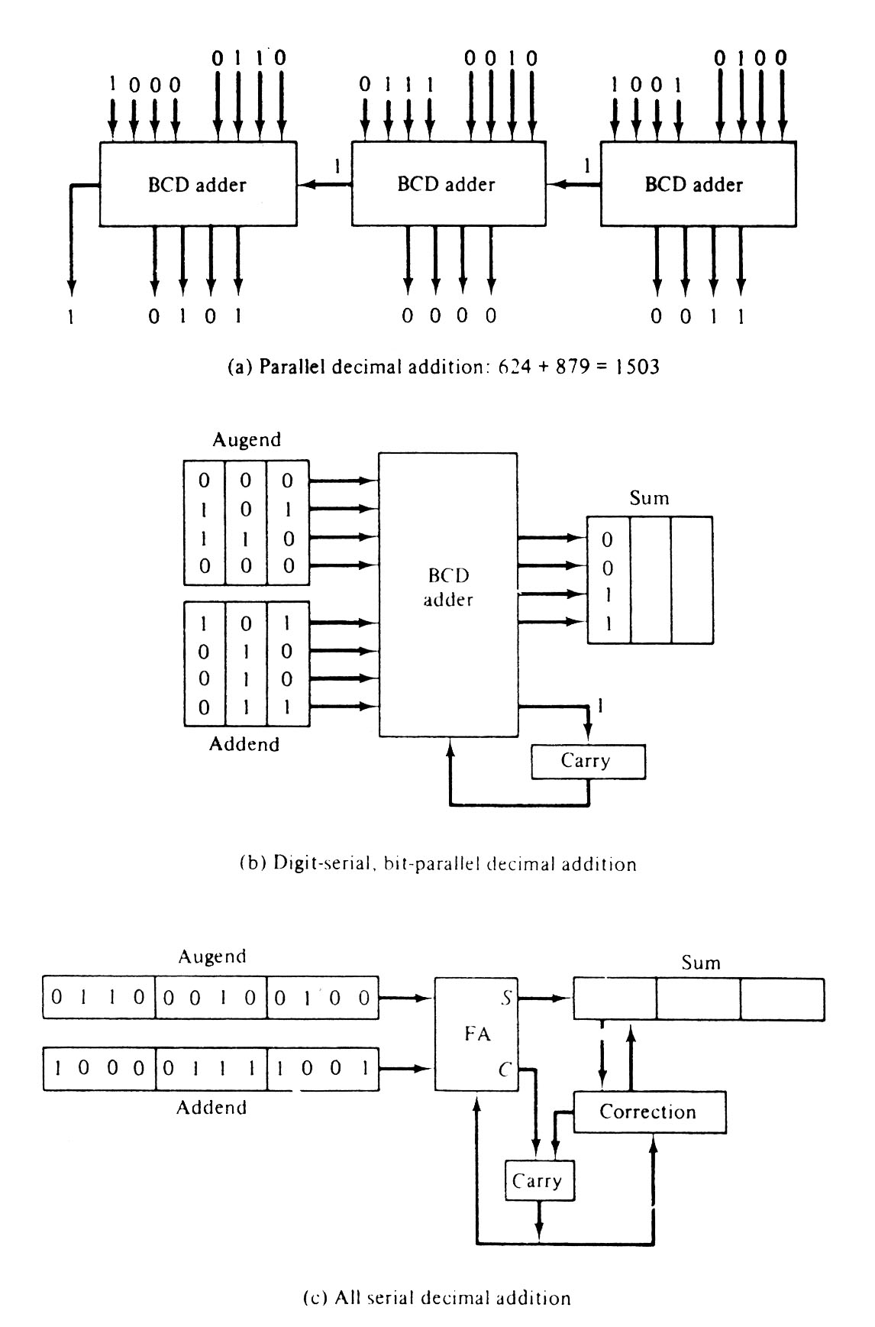

Slide 212
Multiplication
It is similar to binary except for the way the partial products are formed. A decimal multiplier has digits from 0 to 9, whereas a binary multiplier has only 0 and 1. In binary, the multiplicand is added to the partial product. This operation can be done by adding the multiplicand to the partial product a number of times equal to the value of the multiplier digit.

Slide 213
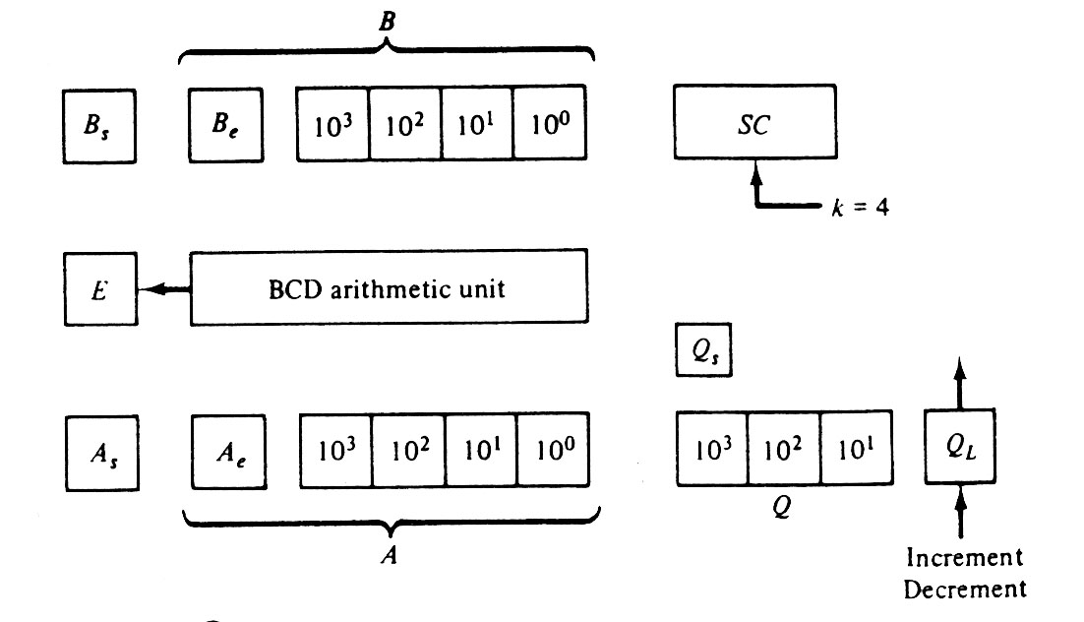

Slide 214
Division
Decimal division is same as that of binary division expect that the quotient digits may have any of the 10 values from 0 to 9. In the restoring division method, the divisor is subtracted from the dividend or partial remainder as many times as necessary until a negative remainder results. Adding the divisor then restores the correct remainder. The digit in the quotient reflects the number of subtractions up to but excluding the one that caused the negative difference.

Slide 215
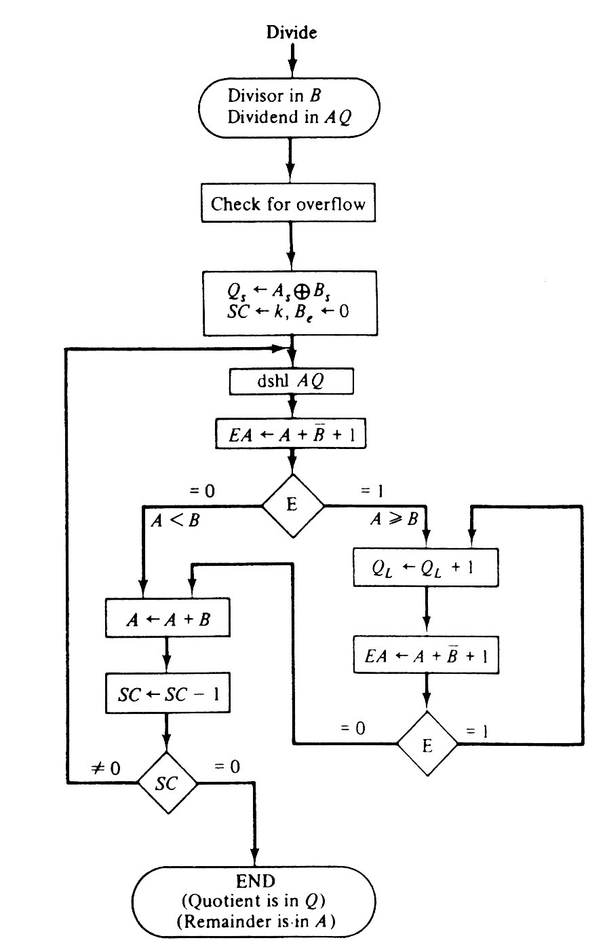

Slide 216
Peripheral Devices
A computer must have a system to get information from the outside world and must be able to the communicate results to the external world. Programs and data should be entered into computer memory for processing and results obtained from computations must be recorded or displayed for the user. The most familiar method of entering information into a computer is using a typewriter like keyboard that allows a person to enter alphanumeric information directly. Every time a key is depressed, the terminal sends a binary coded character to the computer.

Slide 217
Input-Output Interface
Input-output interface gives a method for transferring information between internal memory and I/O devices. Peripherals connected to a computer require special communication links for interfacing them with the central processing unit. The purpose of the communication link is to resolve the differences that exist between the central computer and each peripheral.
The major differences are:

Slide 218
Peripherals are electromechanical and electromagnetic devices and their manner of operation is different from the operation of the CPU and memory, which are electronic devices. Therefore a conversion of signal values may be required.
The data transfer rate of peripherals is usually slower than the transfer rate of the CPU.
Data codes and formats in peripherals differ from the word format in the CPU and memory.
The operating modes of peripherals are different from each other.

Slide 219
I/O Bus and Interface Modules
A communication link between the processor and several peripherals is represented the following figure 6.23. The I/O bus is made of data lines, address lines and control lines. The magnetic disk, printer and terminal are used in any general-purpose computer. The magnetic tape is used in computers for backup storage. Each peripheral device associated with it by interface unit. Each interface decodes the address and control received from the I/O bus, interprets them for the peripheral and provides signals for the peripheral controller.

Slide 220
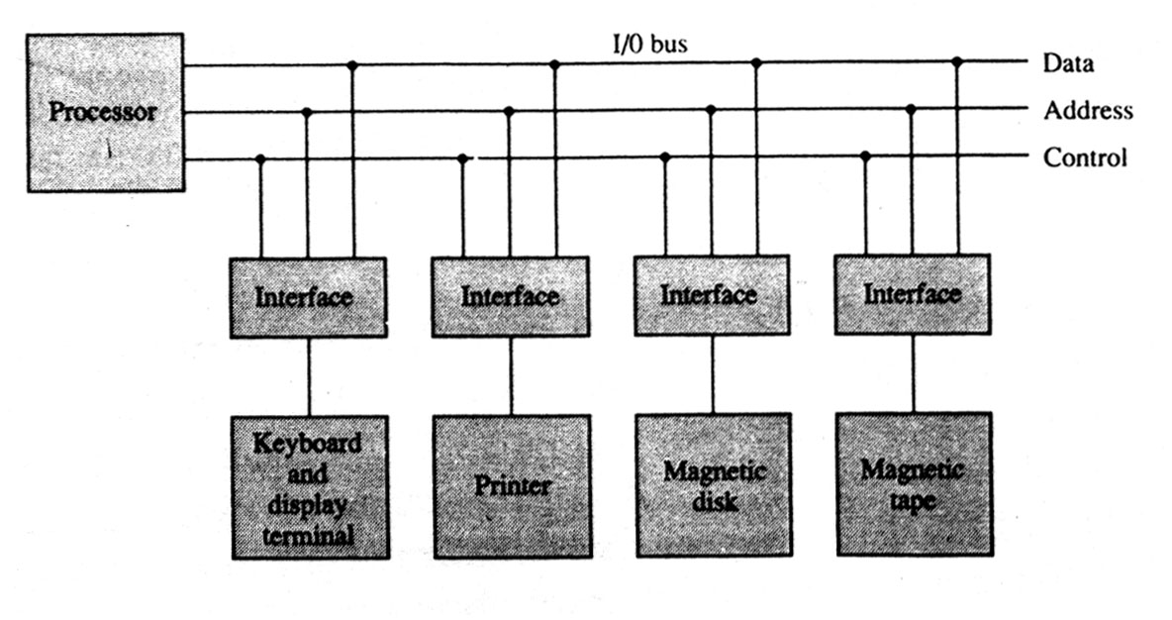
Processor

Slide 221
I/O versus Memory Bus
To communicate with I/O, the processor must communicate with the memory unit. The memory bus contains data, address and read/write control lines. There are three ways to use computer buses to communicate with memory and I/O:
1.Use two separate buses, one for the memory and the other for I/O.
2.Use one common bus for both memory and I/O but have separate control lines for each.
3.Use one common bus for memory and I/O with common control lines.

Slide 222
Isolated versus Memory-mapped I/O
One common bus may be employed to transfer information between memory or I/O and the CPU. Memory transfer and I/O transfer differs in that they use separate read and write lines. The CPU specifies whether the address on the address lines is for a memory word or for an interface register by enabling one of two possible read or write lines. The I/O read and I/O write control lines are enabled during an I/O transfer. The memory read and memory write control lines are enabled during a memory transfer. This configuration isolates all I/O interface addresses from the addresses assigned to memory and is referred to as the isolated I/O method for assigning addresses in a common bus.

Slide 223
Example of I/O interface
The input-output data to and from the device can be transferred into either port A or port B. The interface may operate with an output device or with an input device, or with a device that requires both input and output.
The distinction between data, control, or status information is determined from the particular interface register with which the CPU communicates.

Slide 224
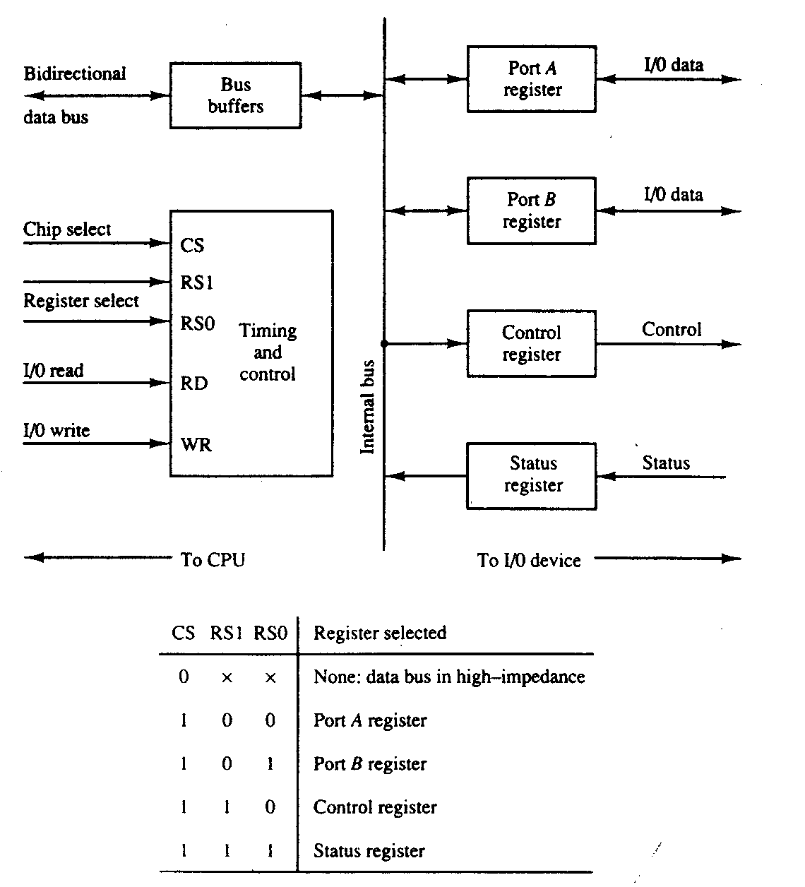

Slide 225
Asynchronous Data Transfer
The internal operations in a digital system are synchronized using a common pulse generator. Clock pulses are used by all registers within a unit and all data transfers among internal registers occur simultaneously during the occurrence of a clock pulse. Two units, such as a CPU and an I/O interface, are independent of each other.

Slide 226
The data bus is used to carry the binary information from source unit to the destination unit. Usually, the bus has multiple lines to transfer an entire byte or word. The strobe is a single line that informs the destination unit when a valid data word is available in the bus.

Slide 227
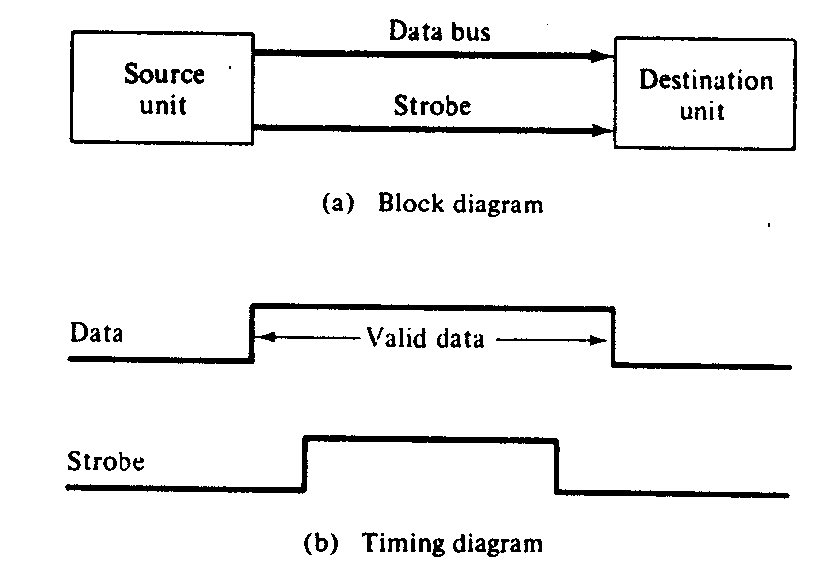

Slide 228
Asynchronous Serial Transfer
We can transfer the data between two units in parallel or serial. In parallel data transmission, each bit has its own path and the total message is transmitted at the same time. In serial data transmission, each bit is sent in sequence one at a time. This method requires the use of one pair of conductors or one conductor and a common ground. Parallel transmission is faster but requires many wires. So we use it for short distances and where speed is important.

Slide 229
Receiver can detect a transmitted character from knowledge of the transmission rules:
1.When a character is not being sent, the line is in the state 1.
2.The initiation of a character transmission is detected from the start bit, which is always 0.
3.The character bits always follow the start bit.
4.After the last bit of the character is transmitted, a stop bit is detected when the line returns to the I-state for at least one bit time.

Slide 230
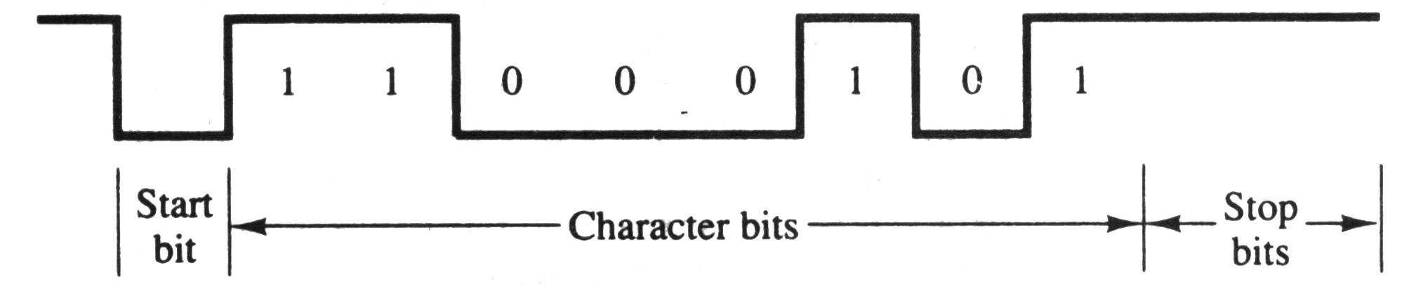

Slide 231
Mode of Transfer
Binary information received from an external device is usually stored in memory. Information transferred from the central computer into an external device initiates in the memory unit. The CPU only executes the I/O instructions and may accept the data temporarily, but the ultimate source or destination is the memory unit. Data transfer between the central computer and I/O devices may be handled in a variety of modes. Some modes use the CPU as an intermediate path; others transfer the data directly to and from the memory unit. Data transfer to and from peripherals may be done in either of three possible modes:

Slide 232
1. Programmed I/O
2.Interrupt-initiated I/O
3.Direct memory access (DMA)
The transfer of each byte needs three instructions:
1.Read the status register.
2.Check the status of the flag bit and branch to step I if not set or to step if set.
3.Read the data register.
A CPU register read each byte and then transferred to memory with a store instruction. I/O programming task is to transfer a block of words from an I/O device and store them in a memory buffer.

Slide 233
SESSION:18

Slide 234
Priority Interrupt
Direct Memory Access
Input Output Processors (IOP)
Serial Communication
Multiprocessors and their characteristics
Interconnection Structures

Slide 235
Priority Interrupt
A priority interrupt establishes a priority to decide which condition is to be serviced first when two or more requests arrive simultaneously. The system may also determine which conditions are permitted to interrupt the computer while another interrupt is being serviced. Higher-priority interrupt levels are assigned to requests, which if delayed or interrupted, could have serious consequences.

Slide 236
Priority Encoder
This circuit implements the priority function. The logic is that if two or more inputs arrive at the same time, the input having the highest priority will take precedence. The truth table of a four-input priority encoder is given in the Table 6.6. The x’s in the table designate don’t-care conditions. Input I₀ has the highest priority.

Slide 237
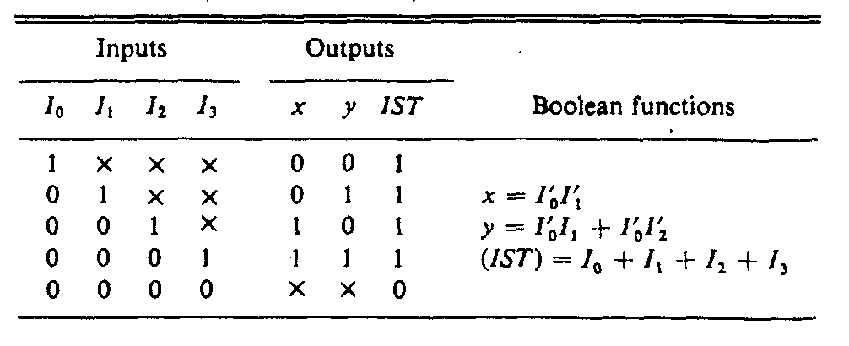

Slide 238
Direct Memory Access (DMA)
We can transfer data direct to and from memory without the need of the CPU. The transfer of data between a fast storage device such as magnetic disk and memory is often limited by the speed of the CPU. Removing the CPU from the path and letting the peripheral device manager the memory buses directly would improve the speed of transfer. This transfer technique is called direct memory access (DMA). During DMA transfer, the CPU is idle and has no control of the memory buses. A DMA controller takes over the buses to manage the transfer directly between the I/O device and memory.

Slide 239
DMA Controller
The DMA controller requires the usual circuits of an interface to communicate with the CPU and an I/O device. It also needs an address register, and count register, and a set of address lines. The address register and address line are used for direct communication with the memory. The word count register specifies the number of words that must be transferred. The data transfer may be done directly between the device and memory under control of the DMA.

Slide 240
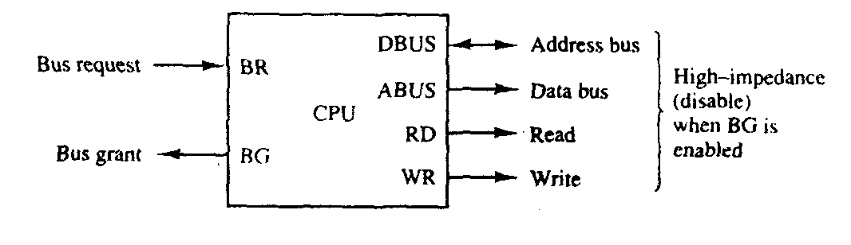

Slide 241
The DMA controller consists of three registers namely an address register, a word count register, and a control register. The address register contains an address to specify the desired location in memory. The address bits go through bus buffers into the address bus. The address register is incremented after each word that is transferred to memory. The word count register holds the number of words to be transferred. This register is decremented by one after each word transfer and internally tested for zero. The control register specifies the mode of transfer. All registers in the DMA appear to the CPU as I/O interface registers. Thus the CPU can read from or write into the DMA registers under program control via the data bus.

Slide 242
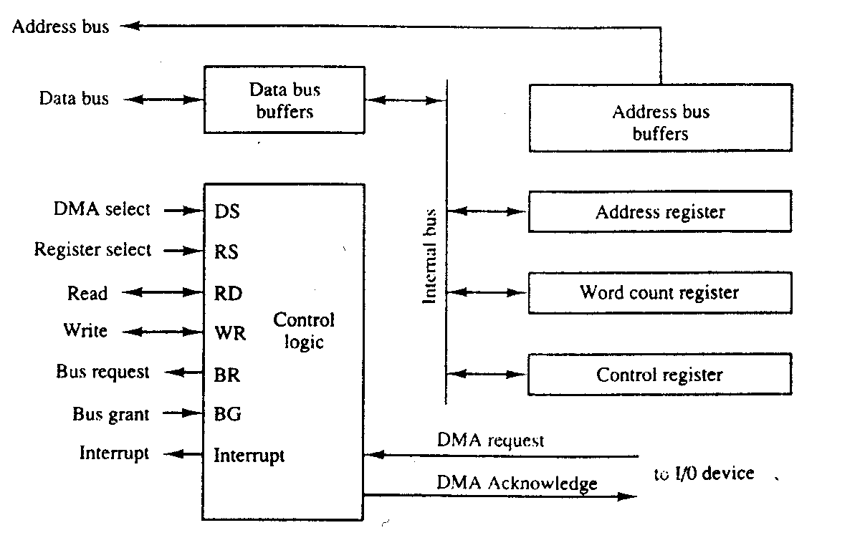

Slide 243
Input-output Processor (IOP)
A computer may incorporate one or more external processors and assign them the task of communicating directly with all I/O devices. An input-output processor (IOP) may be classified as a processor with direct memory access capability that communicates with I/O devices. In this configuration, the computer system can be divided into a memory unit, and a number of processors comprised of the CPU and one or more IOPs. Each IOP takes care of input and output tasks, relieving the CPU from the housekeeping chores involved in I/O transfers.

Slide 244
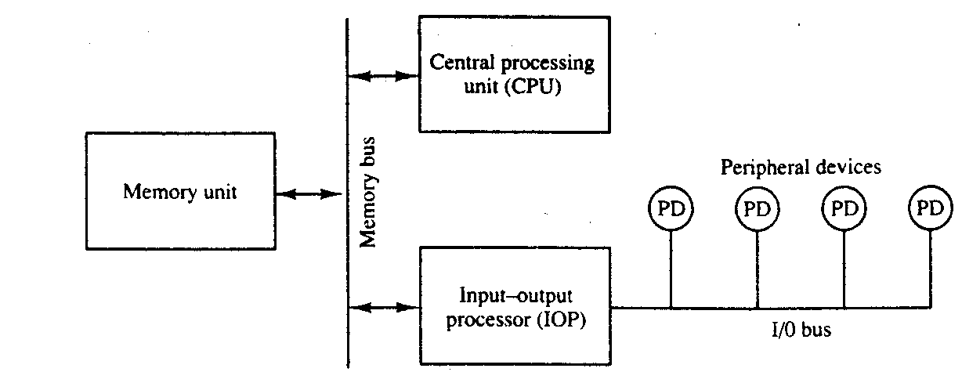

Slide 245
CPU-IOP Communication
There are many form of the communication between CPU and IOP. These are depending on the particular computer considered. In most cases the memory unit acts as a message center where each processor leaves information for the other. To appreciate the operation of a typical IOP, we will illustrate by a specific example the method by which the CPU and IOP communicate.

Slide 246
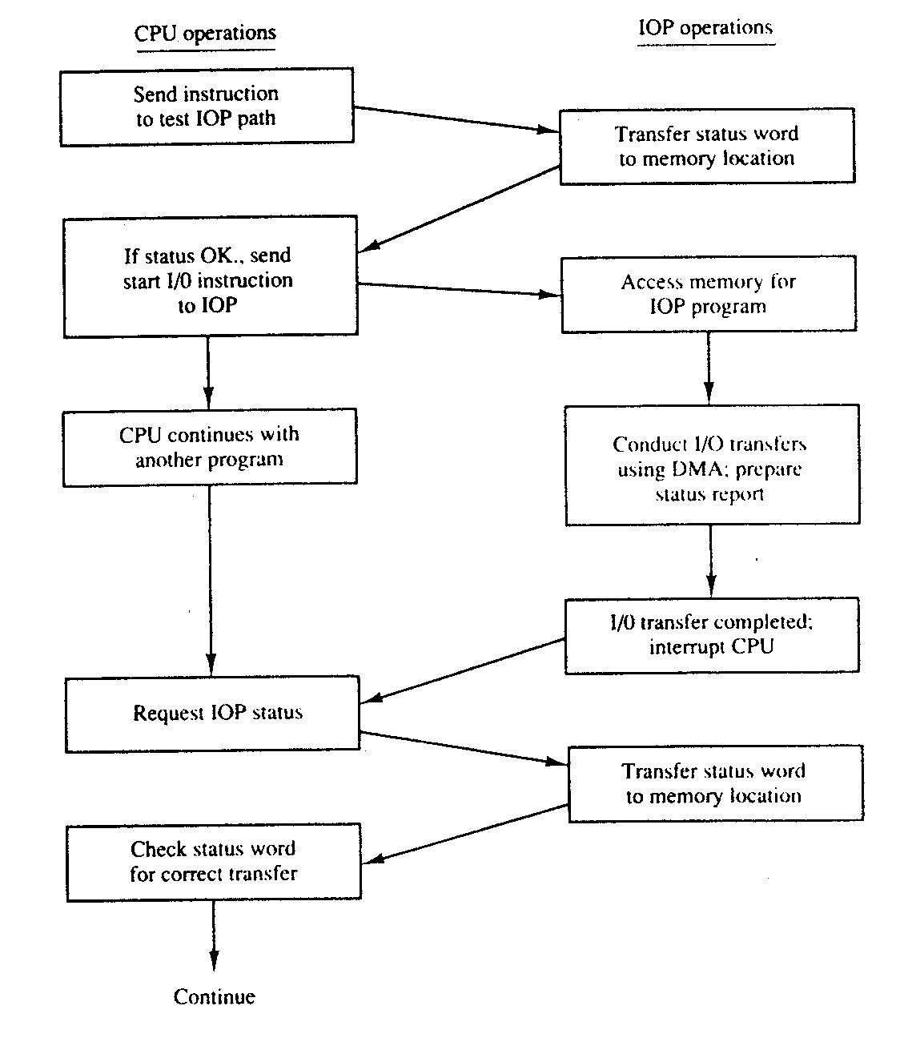

Slide 247
Multiprocessor/Characteristics of Multiprocessor
A multiprocessor system has two or more CPUs. It is an interconnection of two or more CPUs with memory and input-output equipment. The term "processor" in multiprocessor can mean either a central processing unit (CPU) or an input-output processor (IOP). However, a system with a single CPU and one or more lOPs is usually not included in the definition of a multiprocessor system unless the IOP has computational facilities comparable to a CPU. As it is most commonly defined, a multiprocessor system implies the existence of multiple CPUs, although usually there will be one or more lOPs as well. As mentioned earlier multiprocessors are classified as multiple instruction stream, multiple data stream (MIMD) systems.

Slide 248
Multiprocessing improves the reliability of the system so that a failure or error in one part has a limited effect on the rest of the system. If a fault cause one processor to fail, a second processor can be assigned to perform the functions of the disabled processor. The system as a whole can continue to function correctly with perhaps some loss in efficiency.

Slide 249
Time-Shared Common Bus
A common-bus multiprocessor system consists of a number of processors connected through a common path to a memory unit. Only one processor can communicate with the memory or another processor at any given time. Transfer operations are conducted by the processor that is in control of the bus at the time. Any other processor wishing to initiate a transfer must first determine the availability status of the bus, and only after the bus becomes available can the processor address the destination unit to initiate the transfer. A command is issued to inform the destination unit what operation is to be performed. The receiving unit recognizes its address in the bus and responds to the control signals from the sender, after which the transfer is initiated. The system may exhibit transfer conflicts since one common bus is shared by all processors. These conflicts must be resolved by incorporating a bus controller that establishes priorities among the requesting units.

Slide 250
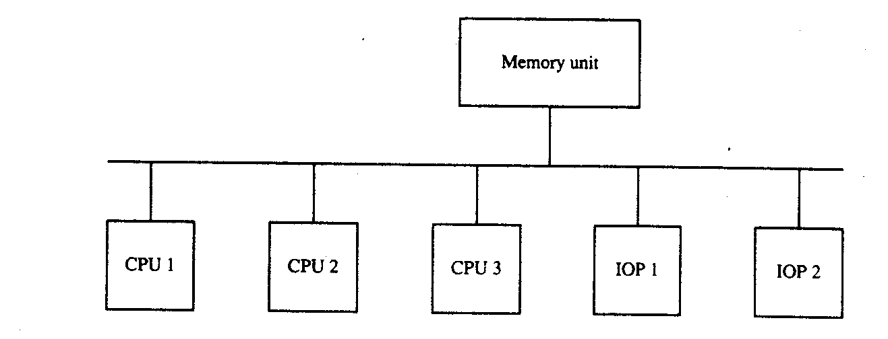

Slide 251
Only one processor can communicate with the shared memory and other common resources through the system bus of any time.

Slide 252
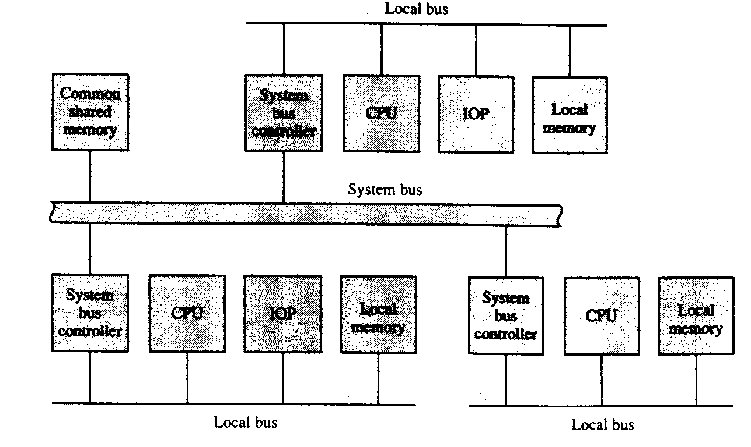

Slide 253
Multiport Memory
A multiport memory system employs separate buses between each memory module and each CPU. This is shown in Fig. 6.48 for four CPUs and four memory modules (MMs). Each processor bus is connected to each memory module. A processor bus consists of the address, data, and control lines required to communicate with memory. The memory module is said to have four ports and each port accommodates one of the buses.

Slide 254
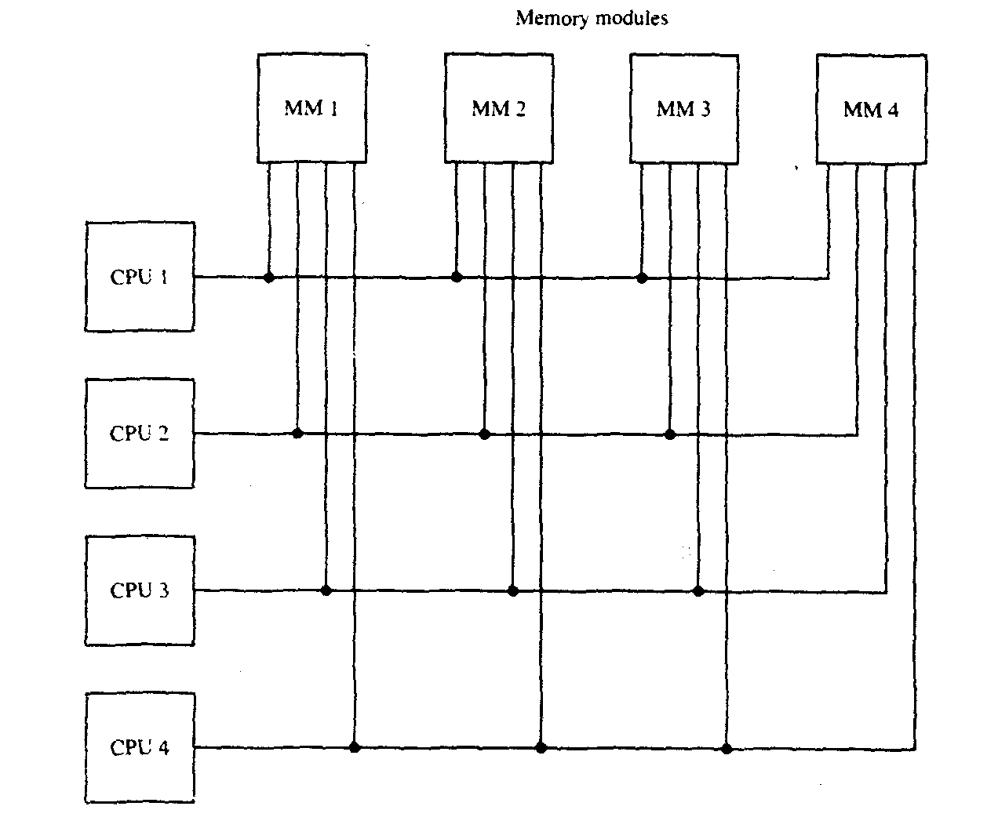

Slide 255
Crossbar Switch
The crossbar switch organization consists of a number of crosspoints that are placed at intersections between processor buses and memory module paths. Figure 6.49 shows a crossbar switch interconnection between four CPUs and four memory modules. The small square in each crosspoint is a switch that determines the path from a processor to a memory module. Each switch point has control logic to set up the transfer path between a processor and memory.

Slide 256
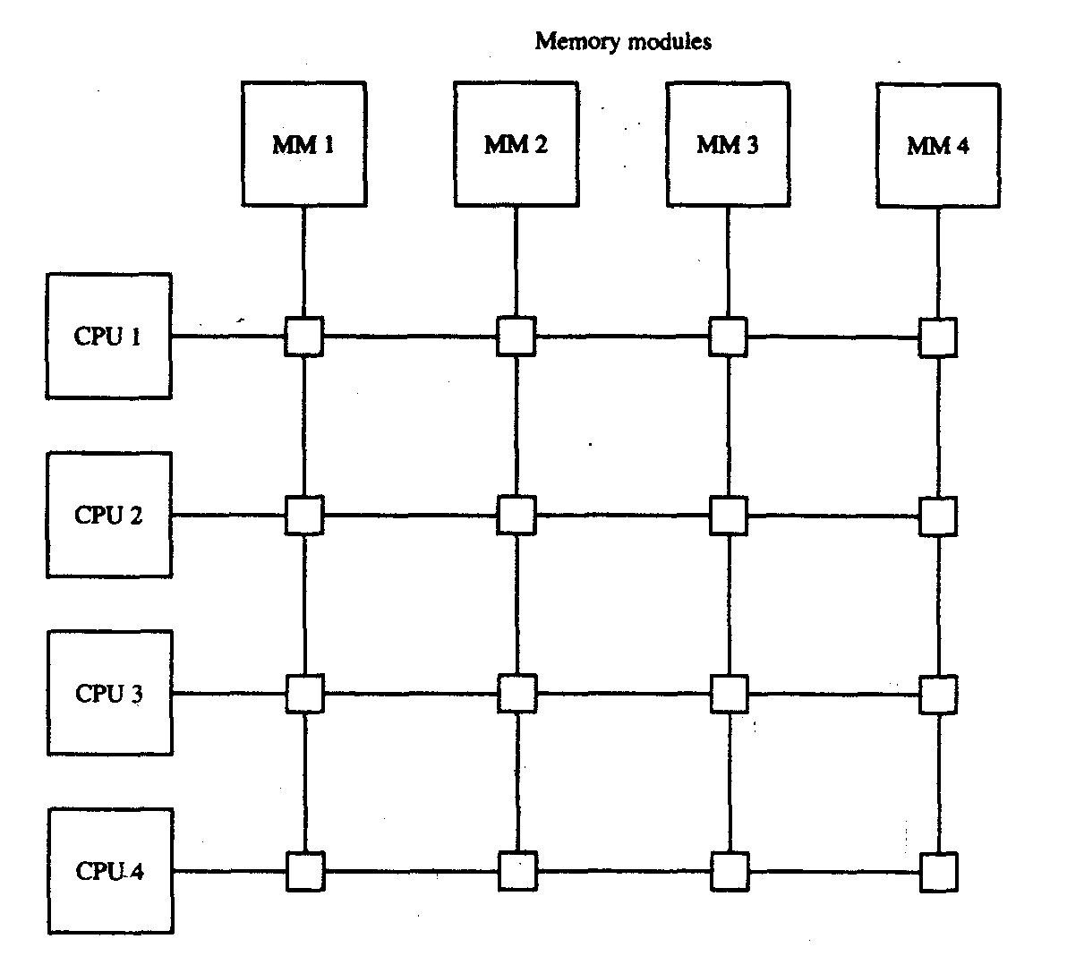

Slide 257
Multistage Switching Network
The basic component of a multistage network is a two-input, two-output interchange switch.
The switch has the capability of connecting input A to either of the outputs. Terminal B of the switch behaves in a similar fashion. The switch also has the capability to arbitrate between conflicting requests. If inputs A and B both request the same output terminal, only one of them will be connected; the other will be blocked.

Slide 258
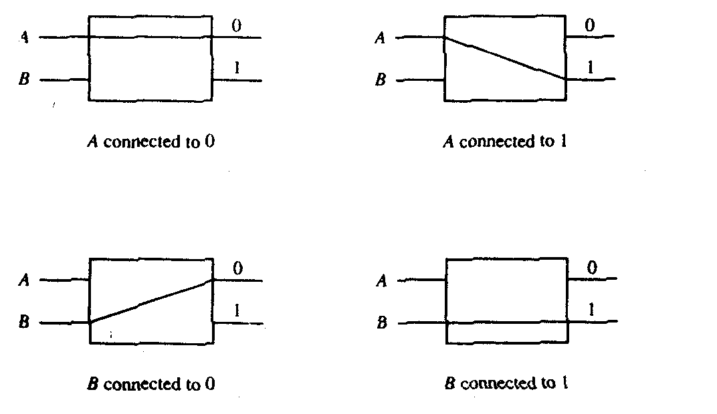

Slide 259
There is exactly one path from each source to any particular destination. Some request patterns, however, cannot be connected simultaneously. For example, any two sources cannot be connected simultaneously to destinations 000 and 001.
8x8 Omega Switching Network

Slide 260
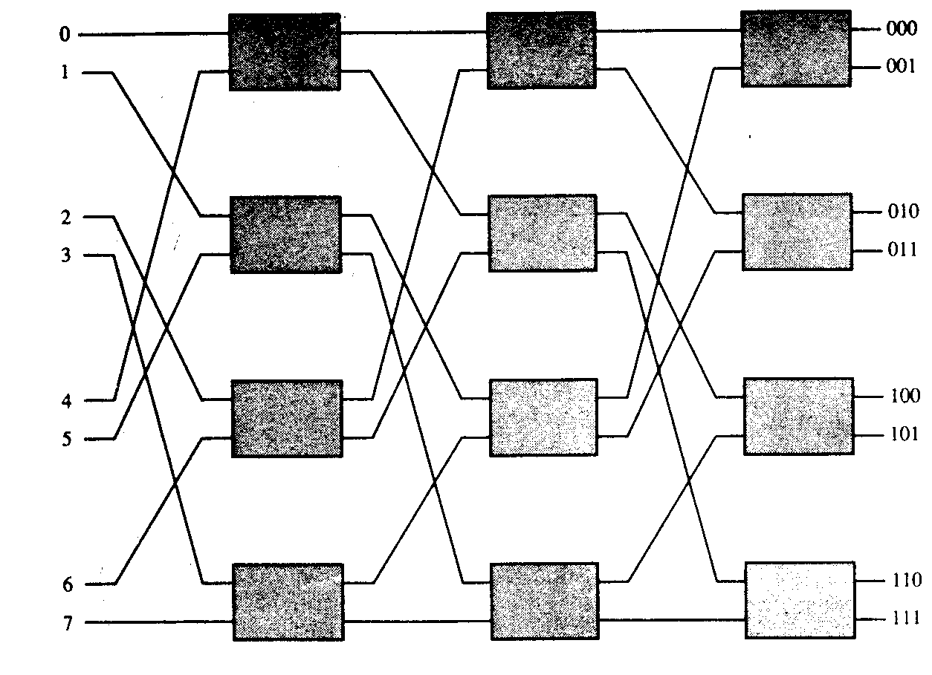

Slide 261
SESSION:19
Interproces Arbitration
Interprocessor communication and Sychronisation
Cache Coherence

Slide 262
Interprocessor Arbitration

Slide 263
Computer systems contain a number of buses at various levels to facilitate the transfer of information between components. The CPU contains a number of internal buses for transferring information between processor registers and ALU. A memory bus consists of lines for transferring data, address, and read/write information. An I/O bus is used to transfer information to and from input and output devices. A bus that connects major components in a multi-processor system, such as CPUs, lOPs, and memory, is called a system bus.

Slide 264
System Bus
A typical system bus consists of approximately 100 signal lines. These lines are divided into three functional groups: data, address, and control. In addition, there are power distribution lines that supply power to the components. For example, the IEEE standard 796 multibus system has 16 data lines, 24 address lines, 26 control lines, and 20 power lines, for a total of 86 lines.

Slide 265
Mutual Exclusion with a Semaphore
A binary variable called a semaphore is often used to indicate whether or not a processor is executing a critical section. A semaphore is a software-controlled flag that is stored in a memory location that all processors can access. When the semaphore is equal to 1, it means that a processor is executing a critical program, so that the shared memory is not available to other processors. When the semaphore is equal to 0, the shared memory is available to any requesting processor. Processors that share the same memory segment agree by convention not to use the memory segment unless the semaphore is equal to 0, indicating that memory is available. They also agree to set the semaphore to 1 when they are executing a critical section and to clear it to 0 when they are finished.

Slide 266
Cache Coherence
When the processor finds a word in cache during a read operation, the main memory is not involved in the transfer. If the operation is to write, there are two commonly used procedures to update memory. In the write-through policy, both cache and main memory are updated with every write operation. In the write-back policy, only the cache is updated and the location is marked so that it can be copied later into main memory. In a shared memory multiprocessor system, all the processors share a common memory. In addition, each processor may have a local memory, part or all of which may be a cache. The compelling reason for having separate caches for each processor is to reduce the average access time in each processor .

